Slide 1
2nd ESSnuSB Open Meeting
CERN 26-27 May 2014
https://indico.in2p3.fr/conferenceDisplay.py?confId=10090
SPL R&D and ESSnuSB
R. Garoby

Slide 2
Status of the SPL
Low energy ν Superbeam option
Pending issues & synergies with ESSnuSB

Slide 3
SPL main characteristics
General features
Required for low loss in accumulator
Ion species H⁻
Output Energy 5 GeV
Bunch Frequency 352.2 MHz
Repetition Rate 50 Hz
High speed chopper < 2 ns
(rise & fall times)
Required for muon production (Neutrino Factory)
Re-use of LEP RF components in Front-end (Linac4)
Required for flexibility and low loss in accumulator
Options
 | Option 1 | Option 2
Energy (GeV) | 2.5 or 5 | 2.5 and 5
Beam power (MW) | 2.25 MW (2.5 GeV) or 4.5 MW (5 GeV) | 5 MW (2.5 GeV) and 4 MW (5 GeV)
Protons/pulse (x 10¹⁴) | 1.1 | 2 (2.5 GeV) + 1 (5 GeV)
Av. Pulse current (mA) | 20 | 40
Pulse duration (ms) | 0.9 | 1 (2.5 GeV) + 0.4 (5 GeV)
RIB facility
ν facility
2 × beam current ⇒ 2 × nb. of klystrons etc .

Slide 4
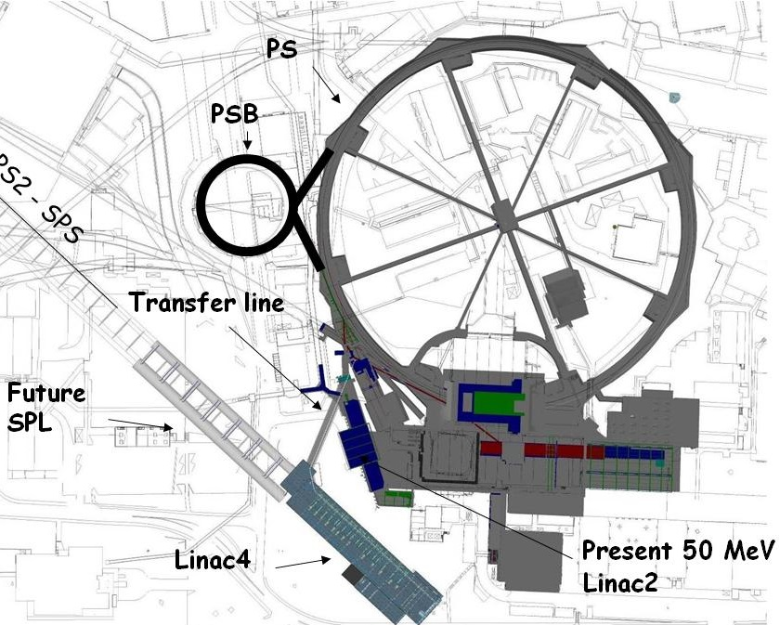
SPL potential front end: Linac4!
(Construction Project started in January 2008)
New 160 MeV H- linear accelerator, will replace Linac2 as injector to the PS Booster.
First step of the LIU upgrades.
Bunch Frequency 352.2 MHz
Max. Rep. Frequency 2 Hz
Max. Beam Pulse Length 0.4 ms
Max. Beam Duty Cycle 0.08 %
Chopper Beam-on Factor 65 %
Chopping scheme: 222 transmitted /133 empty buckets
Source current 80 mA
RFQ output current 70 mA
Linac pulse current 40 mA
Tr. emittance (source) 0.25 π mm mrad
Tr. emittance (linac exit) 0.4 π mm mrad
Max. repetition frequency for accelerating structures 50 Hz
Doubled beam brightness for LHC luminosity: reduced space charge (factor 2 in βγ² ) with a higher PSB injection energy
Long term reliability using modern design, (concerns for Linac2 vacuum ).
Flexible operation and reduced loss with new technologies (chopping, H⁻ injection).
Higher intensity for non-LHC users.
Prepare for a possible high-intensity upgrade (neutrino facility).
Test stand
Notes:
No space for energy upgrade – parallel to the present Linac2

Slide 5
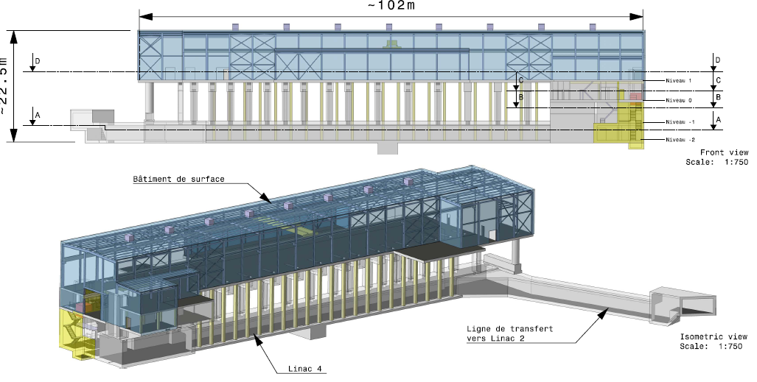
Linac4
45keV
3MeV
3MeV
50MeV
103MeV
160MeV
H-
RFQ
CHOPPER
DTL
CCDTL
PIMS
RF volume
source
(DESY)
45 kV
Extrac.
Radio
Frequency
Quadrupole
3 m
1 Klystron
550 kW
Chopper
& Bunchers
3.6 m
11 EMquad
3 cavities
Drift Tube
Linac
18.7 m
3 tanks
1+2 klystrons
4.7 MW
111 PMQs
Cell-Coupled Drift Tube
Linac
25 m
21 tanks
7 klystrons
7 MW
21 EMQuads
Pi-Mode Structure
22 m
12 tanks
4+4 klystrons
~12 MW
12 EMQuads
H⁻ ion current:
40 mA (avg.),
65 mA (peak)
Length: 80 m
19 klystrons [13 x 1.3 MW (LEP), 6 x 2.8 MW (new)]
Normal conducting accelerating structures of 4 types: RFQ, DTL, CCDTL, PIMS
Single frequency: 352.2 MHz
Duty cycle: 0.1% phase 1 (Linac4), 3-4% phase 2 (SPL), (design: 10%)

Slide 6
SPL block diagram
SC-linac [160 MeV → 5 GeV] with ejection at intermediate energy
Medium beta cavities: β = 0.65
High beta cavities: β = 1
“Up-to-date” CDR to be published in 2014
0 m
0.16 GeV
129 m
0.73 GeV
280 m
2.5 GeV
505 m
5 GeV
From Linac4
Medium β cryomodule
High β cryomodules
Ejection
High β cryomodules
Debunchers
5 GeV – 4 MW
20 x 3
β=0.65 cavities
10 x 8
β=1 cavities
13 x 8
β=1 cavities
2.5 GeV
Length: ~500 m

Slide 7
SPL cavities development
Collaboration with ESS (Lund) with contributions from IN2P3 and CEA and support from the E.U.
Medium beta cavities β = 0.65
  1 designed and ordered from industry by IPN Orsay (Guillaume Olry et al.) to be tested in 2014 at CEA Saclay in vertical cryostat and later in Cryho-lab (Horizontal test cryostat)
High beta cavities β = 1
  1 designed and ordered from industry by CEA Saclay (Guillaume Devanz et al.) to be tested in 2014 at CEA Saclay in vertical cryostat and later in Cryho-lab (Horizontal test cryostat)
  5 designed and ordered (4 from industry, 1 from CERN workshop) by CERN for tests at CERN (SM18) in Short cryo-module of 4 cavities

Slide 8
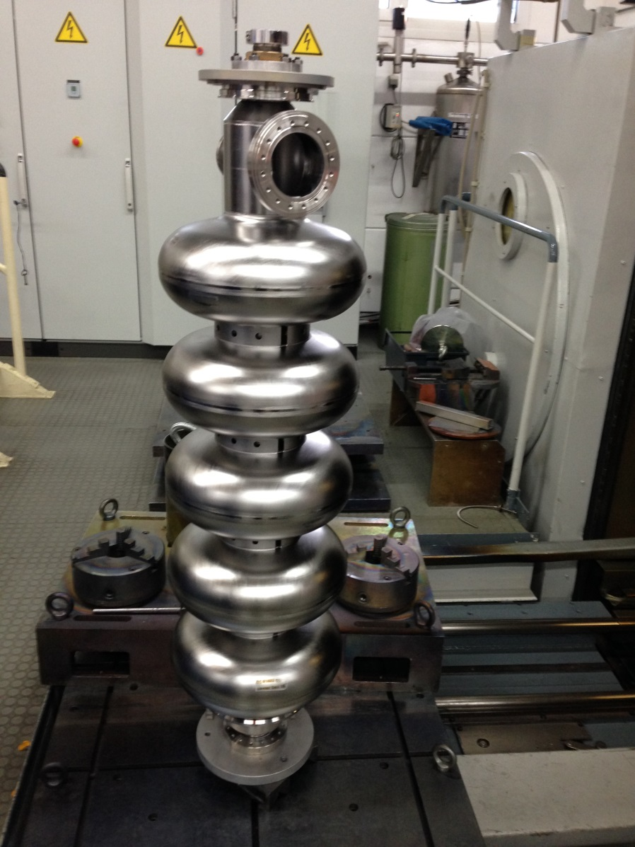
Niobium cavities from industry (RI)
4 Niobium cavities fabricated and delivered by RI (December 2013)

Slide 9
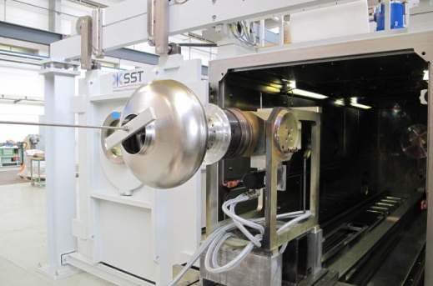
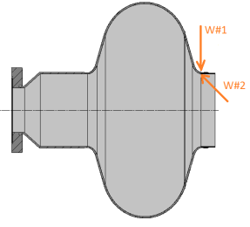
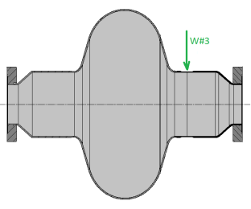
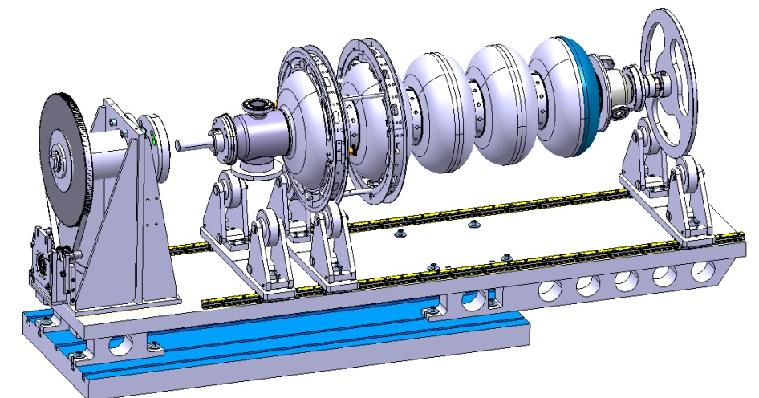
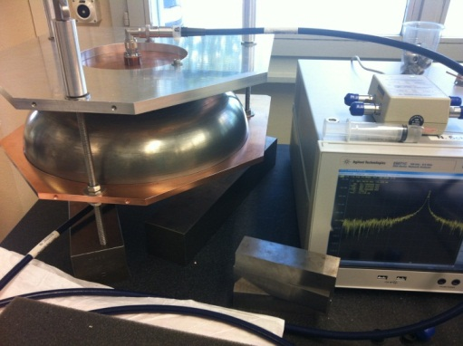
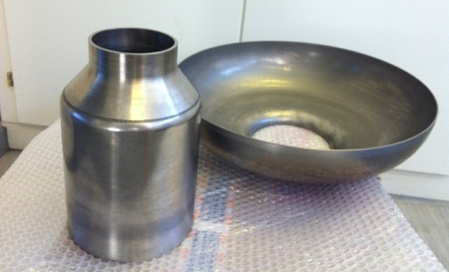
Niobium cavities at CERN
Repair of first monocell
Material defects observed after electro-polishing.
Repaired with new e-beam welding machine from outside (W#1 and W#3) and inside (W#2)
cavity fabrication at CERN
Tooling for EB welding of Nb cavity is fabricated.
Half-cells and beam tubes fabricated by spinning.
RF measurements.

Slide 10
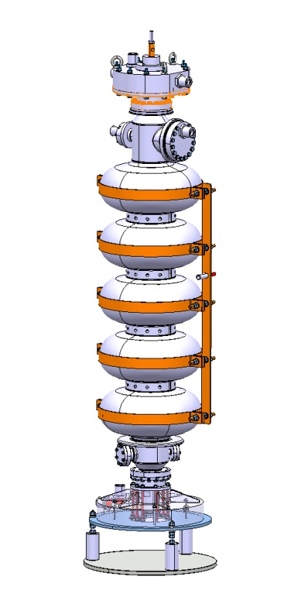
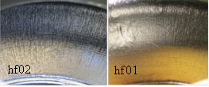
Electro-Polishing (EP)
Tooling for EP
- 5 Cell electropolishing preparation:
Cathode and tooling manufacturing
Improve main pump flow control and compressed air connection
Allow crane direct acces to the electropolishing hut
- Monocell TESTS:
A second set of electropolishing sessions were done to bring the total removed thickness to 200 microns.
It was possible to set different working temperatures and compare them with the simulation data
Working at lower temperatures results in less pitting.
Cavity is currently undergoing RF test
Paper TUP047 bat SRF with all multiphysics simulation details
Temperature | Total current inward / A
 | Simulation | Real cavity
10 °C | 21 | 18
15 °C | 37 | 36
25 °C | 70 | 57

Slide 11
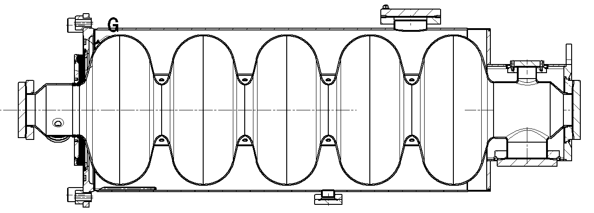
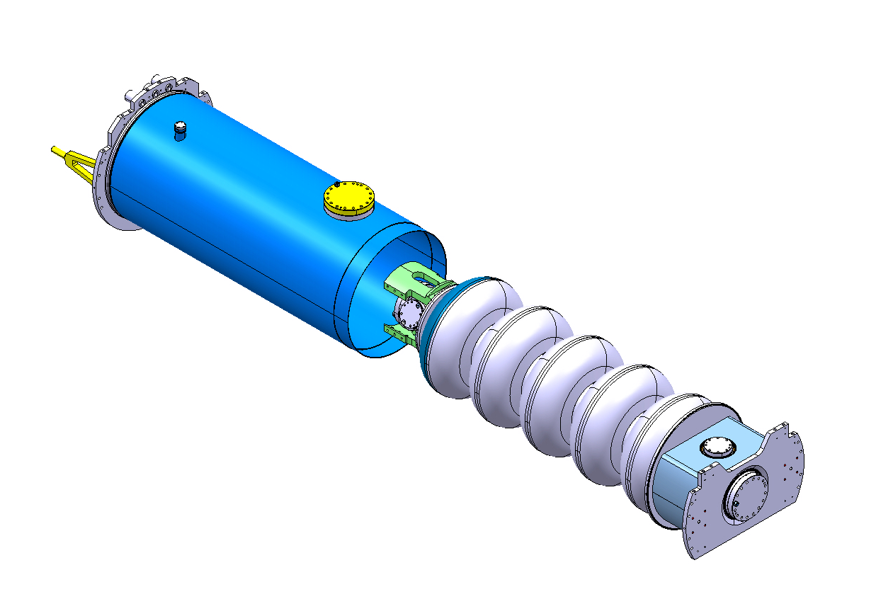
Helium tank
Stainless Steel He tank (CEA)
Helium tank designed by CERN (Stainless steel).
5 items under fabrication by CEA (with SDMS).

Slide 12
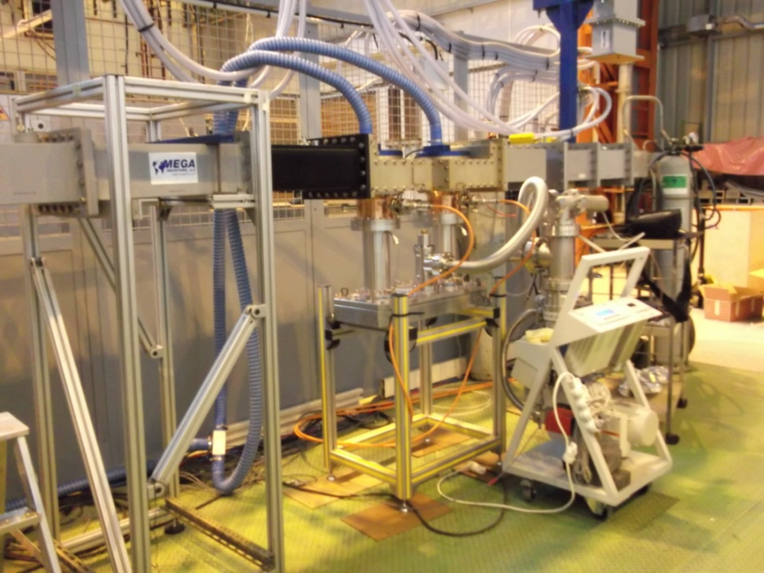
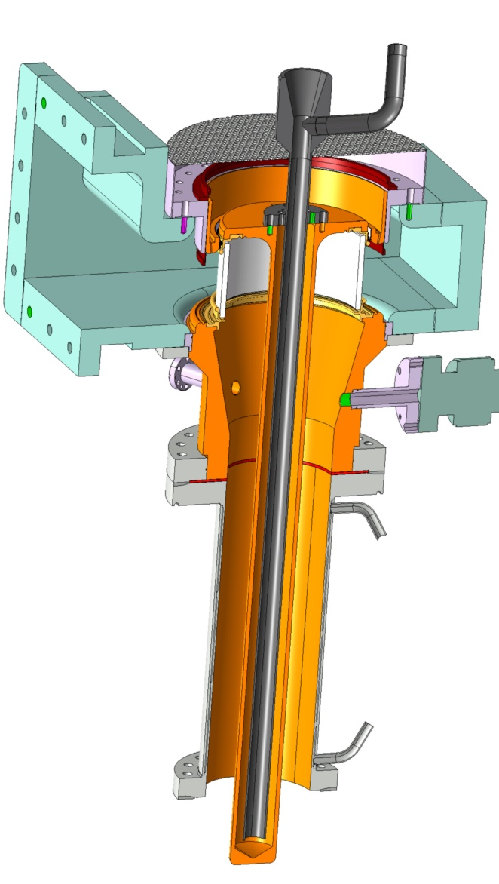
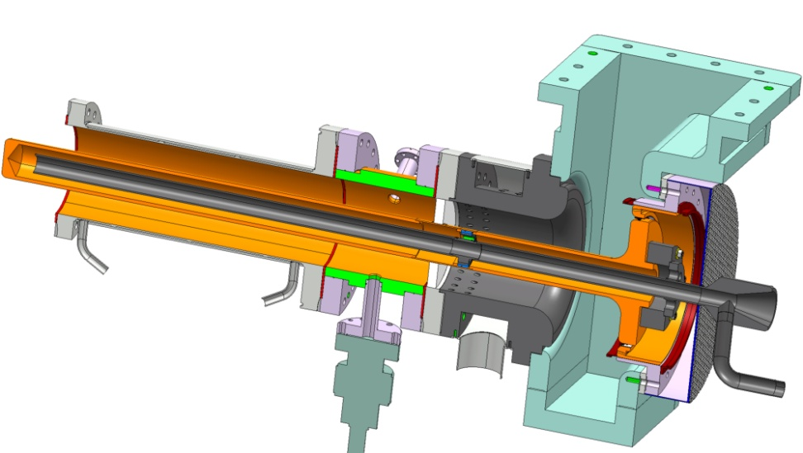
RF tests on couplers at CEA
Test of RF couplers (CEA)
Development of
two types of couplers
Cylindrical
window
Disk
window
CEA test bench with
two SPL cylindrical window couplers,
Double Walled Tubes and Test Box cavity

Slide 13
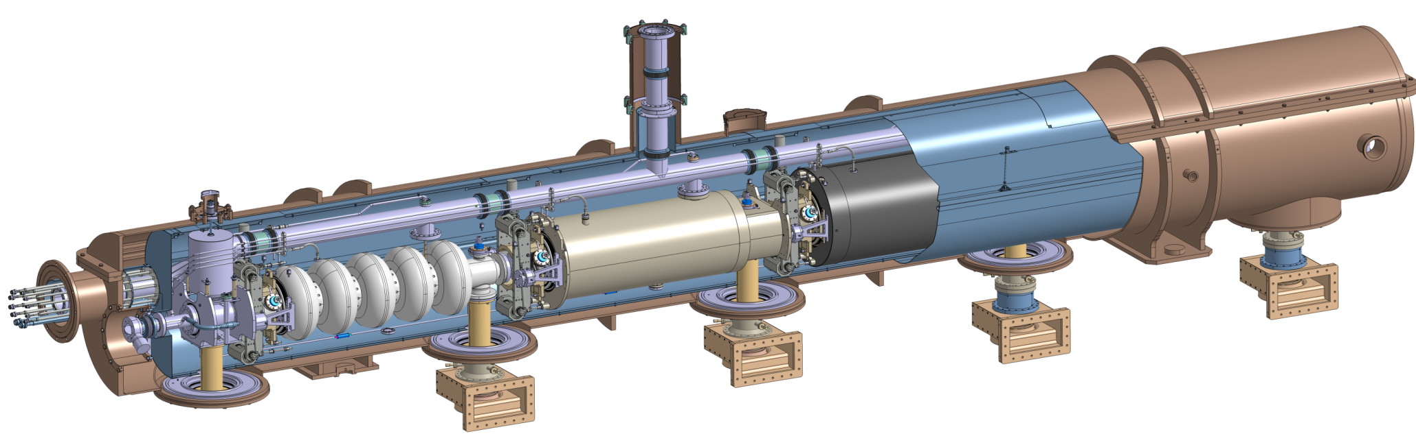
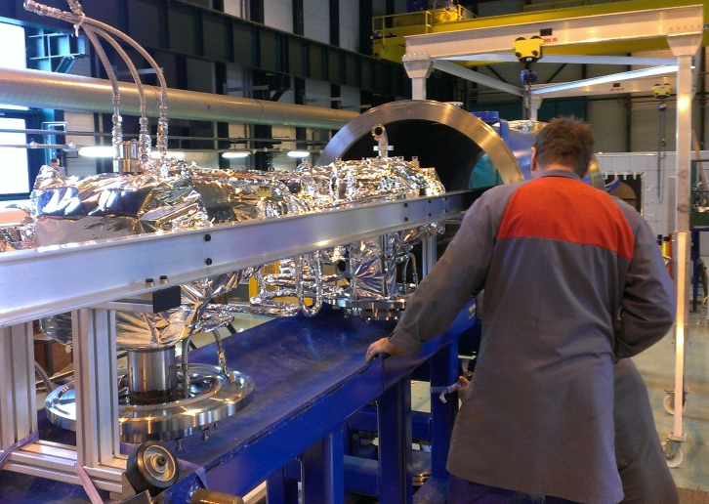
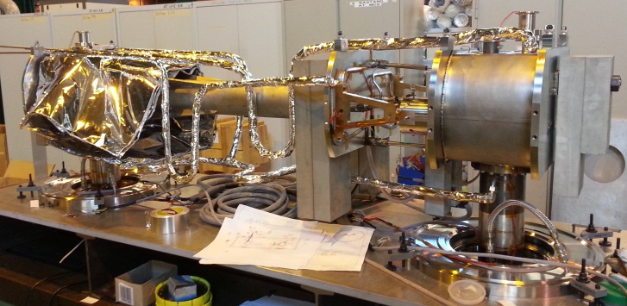
Cryomodule
Collaboration with ESS (Lund) with contributions from IN2P3 and CEA
Cryogenic circuit
burst disk
Insulation vacuum
relief plate
Thermal shield
Cryogenic lines port
Vacuum vessel
Helium tank
Magnetic shielding
Two-phase pipe
He phase separator
Thermal shield tie-rod
Cavity tuner
RF coupler
Inter-cavity
support
Gate valve
Cold-to-warm
transition
Cavity
Double-walled
tube
Assembly of supporting system mock-up
Inner part of supporting system mock-up

Slide 14
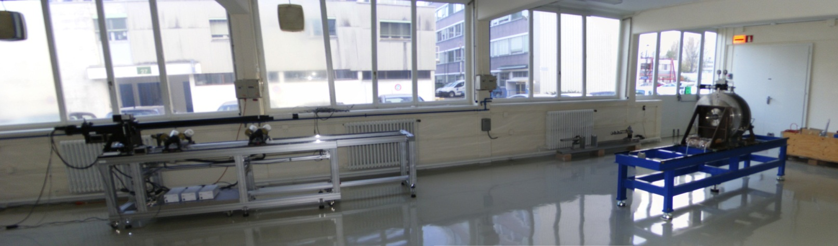
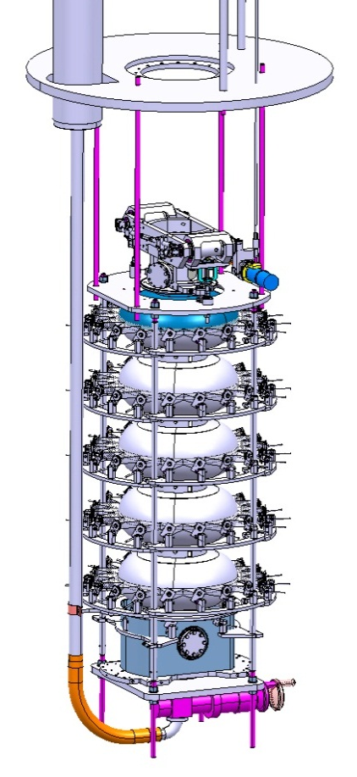
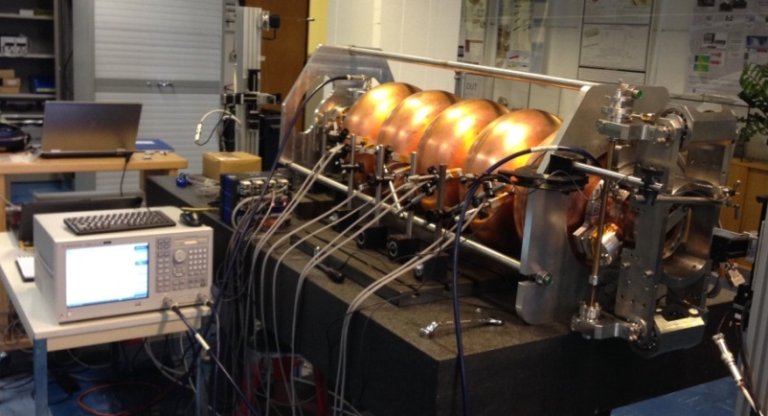
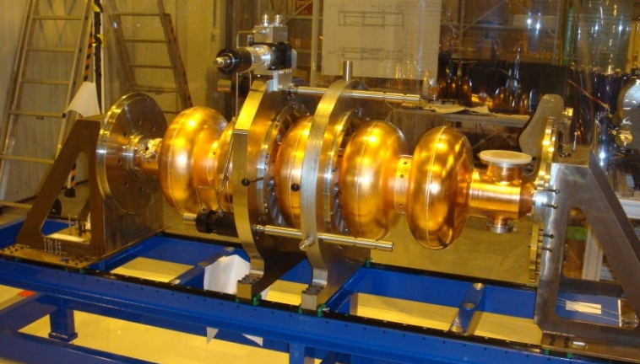
Tests systems and cavity reception area (Bdg. 252)
Reception area in bdg.252
Tooling for test in vertical cryostat: fabricated and available at CERN
Cavity tuner: measurement of cavity detuning versus mechanical deformation.
Cell-by-cell tuning system with RF bead-pull and mechanical measurements.

Slide 15
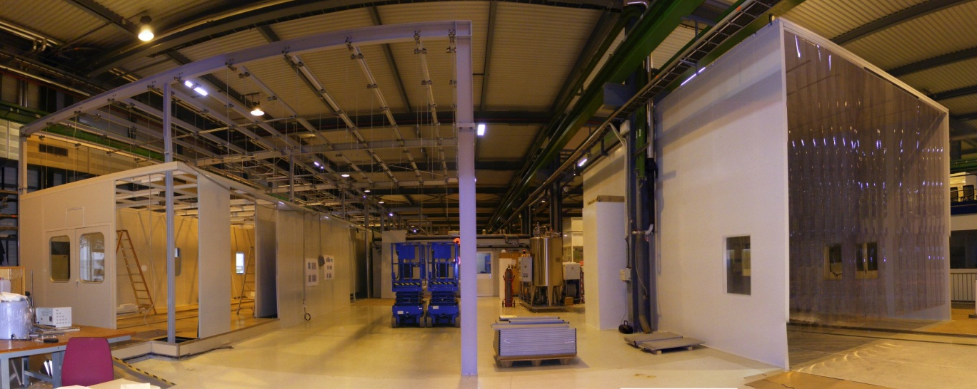
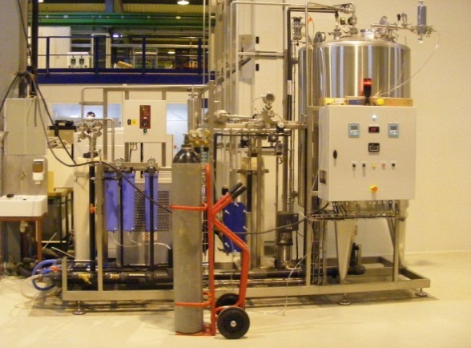
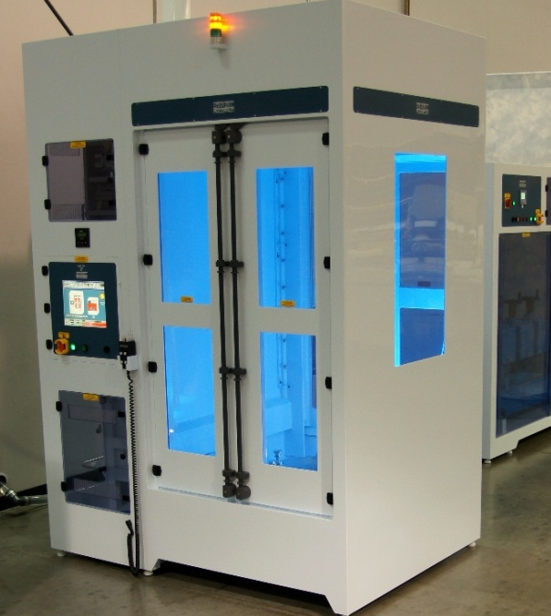
SM18 Assembly & cryogenic infrastructure
Cryogenics
  New cryogenic transfer line: commissioned December 2013
  Modification of 2 Vertical Cryostats for 2K Operation: completed March 2013
  Specifications of He distribution for Horizontal Cryostats (2K and 4.5 K operation) completed
SRF processing infrastructure
  Main Clean Room Upgrade and Extension: to be finished in December 2013
  Ultra-Pure Water Station delivered and commissioned: October 2013
  Rinsing Cabinet delivered: October 2013
  Diagnostics
    2nd sound measurement by OSTs: operational (more work required for interpretation…)
    Temperature mapping system for SPL cavities: work in progress…

Slide 16
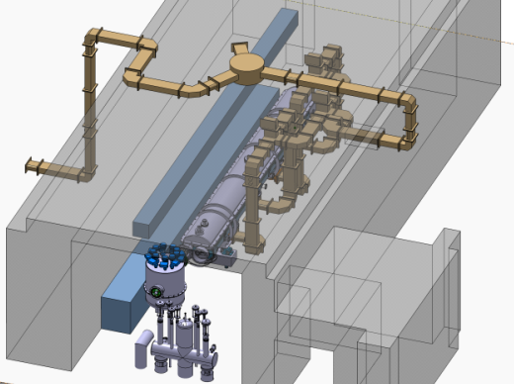
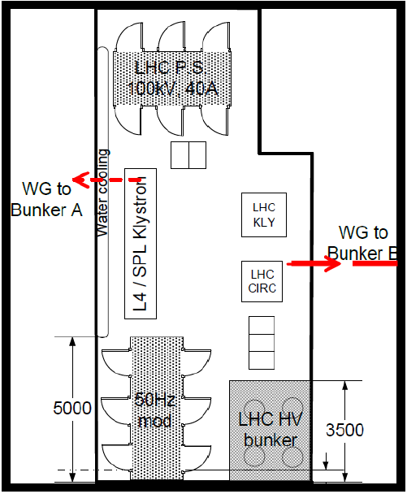
SM18 RF infrastructure
1.5 MW Thales klystron – Mid-2014
Klystron modulator – Delivered May 2014
New Low Level RF at 704 MHz – End 2014
RF
distribution
Cryo-module
Valve box
Cryo line interface

Slide 17
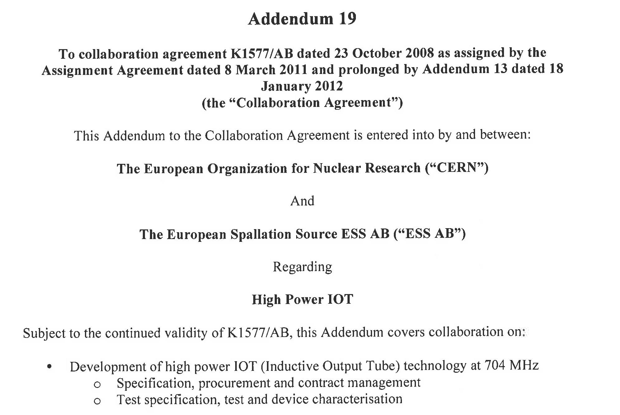
High Power IOT development (704 MHz)
Collaboration with ESS (Lund)
    Two 1.5 MW IOTs being ordered by ESS
    Test set-up in preparation at CERN
    Full characterization in 2015-2016 (joint ESS-CERN)

Slide 18
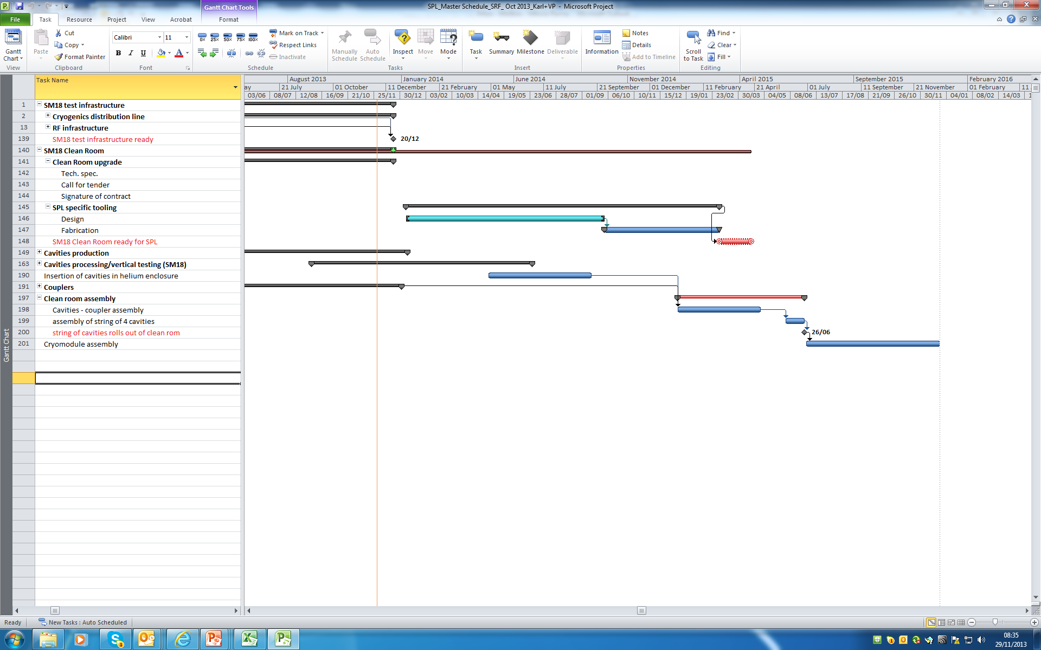
SPL R&D schedule
Start of test of string of four
β =1 cavities in a short cryo-module
Preparation of components
Assembly of CM
2014
2015

Slide 19
Status of the SPL
Low energy ν Superbeam option
Pending issues & synergies with ESSnuSB

Slide 20
Arguments for a linac-based proton driver
1. Safe and proven set-up
There is no doubt that an sc linac can be built to reliably deliver multi-MW of beam power up to 4-8 GeV. Proof of existence is given by SNS.
2. Acceleration up to a few GeV in a single machine
Accelerating up to the final energy in a linac avoids beam transfers and guarantees very low beam loss in the accelerator itself.
3. “Easy” ring(s)
Synchrotron(s) is (are) needed to transform the long linac pulse (nx100 μs) into shorter pulse(s). It is however much simpler than an RCS because of:
- no space charge
- no need to accelerate ( CW power supply and magnets, ordinary vacuum chamber, simpler RF system, no capture loss…)
- ~no time for instabilities to develop.

Slide 21
Linac-based proton driver: principle [1/2]
Parameter | Basic value | Range
Beam energy [GeV] | 10 | 5 - 15
Burst repetition rate [Hz] | 50 | ?
Number of bunches per burst (n) | 4 | 1 – 6 ?
Total duration of the burst [μs] | ~ 50 | 40 - 60
Time interval between bunches [μs] (t_{int}) | 16 | ~ 50/(n-1)
Bunch length [ns] | 2 | 1 - 3
Specifications
(from ISS report)
SPL-based 5 GeV – 4 MW proton drivers have been designed [SPL + 2 fixed energy rings (accumulator & compressor)] which meet these requirements
References:
  SPL based proton driver/ R. Garoby, talk at NuFact06, http://nufact06.physics.uci.edu/Workshop/Slides/RGaroby_SPL3_Pdriver.ppt
  Feasibility Study of Accumulator and Compressor for the 6-bunches SPL-based Proton Driver / M. Aiba, CERN-AB-2008-060
  A first analysis of 3-bunches and 1-bunch scenario for the SPL-based Proton Driver / M. Aiba, CERN-AB-Note-2008-048-BI
  Beam Stability in the SPL Proton Driver Accumulator for a Neutrino Factory at CERN / E. Benedetto, http://nufact09.iit.edu/wg3/wg3_benedetto-splstability.ppt, to be published
  SPL-based Proton Driver for a Neutrino Factory at CERN, M. Aiba, E. Benedetto, R. Garoby, M. Meddahi, poster nb.25 (this workshop)

Slide 22
Linac-based proton driver: principle [2/2]
Beam accumulation
  Accumulator ring
        Charge exchange injection
        ~nx100μs accumulation time
        Isochronous (η=0): beam frozen longitudinally to preserve Δp/p
        No RF (=> minimum impedance)
        1-6 bunches of ~120 ns length
Bunch compression
  Compressor ring
        Large RF voltage (large stored energy & minimum RF power) (=> bunch rotation on stored energy)
        Large slippage factor η => rapid phase rotation in few x10μs,
        ~2ns rms bunch length @ extraction to the target (=> moderate ΔQ because of dispersion)
Synchronization between rings
  - Ratio of circumferences guaranteeing correct positioning of successive bunches inside the compressor without energy change in any ring

Slide 23
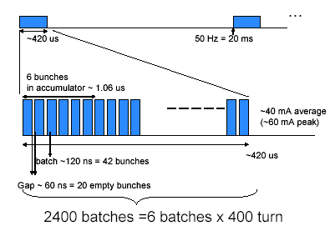
Generation of 6 bunches [1/4]
SPL
Accumulator

Slide 24
Generation of 6 bunches [2/4]
Accumulator
[120 ns pulses -
60 ns gaps]
Accumulation | Duration = 400 μs
Compression | t = 0 μs
 | t = 12 μs
 | t = 24 μs
 | t = 36 μs
 | etc. until t = 96 μs
SPL beam
[42 bunches -
21 gaps]
Compressor
[120 ns bunch -
V(h=3) = 4 MV]
Target
[2 ns bunches – 6 times]

Slide 25
Bunch rotation (case of 6 bunches) [3/4]
from M. Aiba

Slide 26
Main Parameters (case of 6 bunches) [4/4]
from M. Aiba

Slide 27
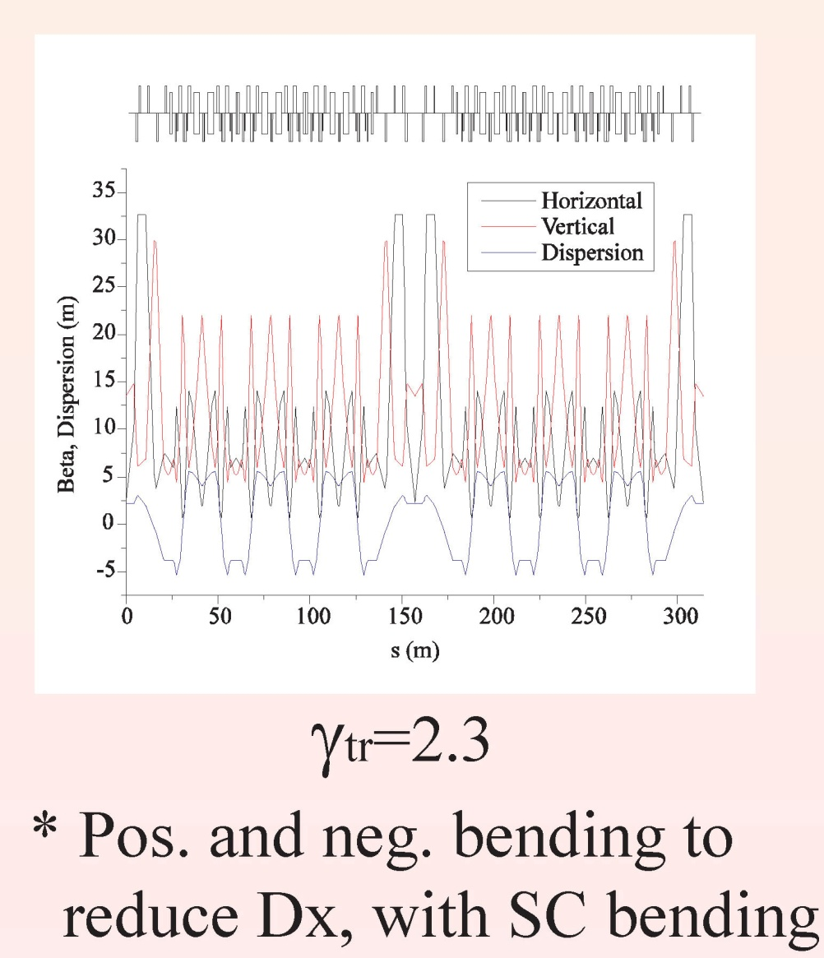
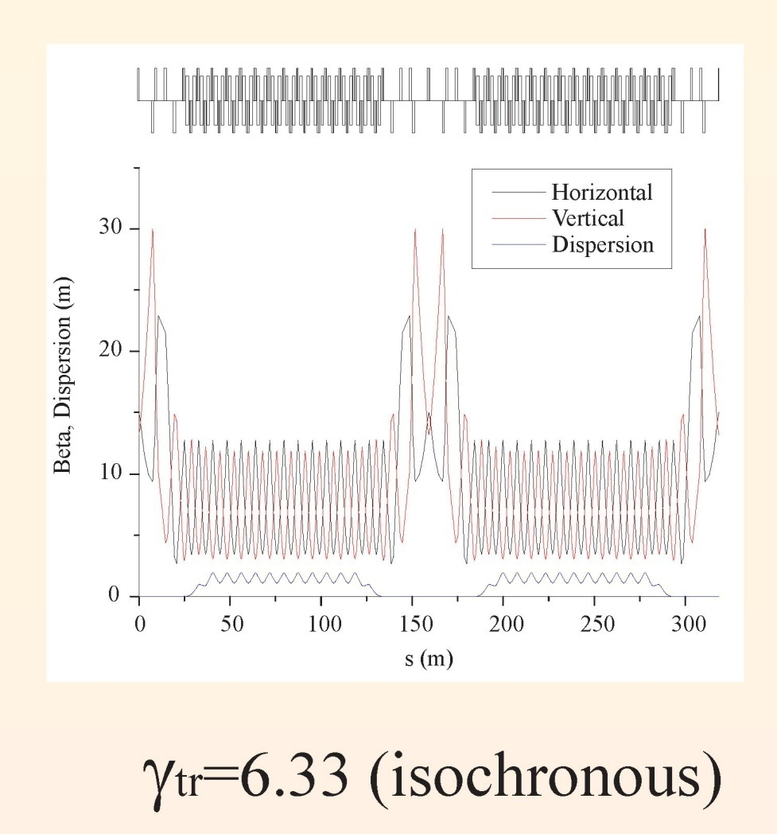
Synchrotons lattices (6 bunches)
from M. Aiba
COMPRESSOR
ACCUMULATOR

Slide 28
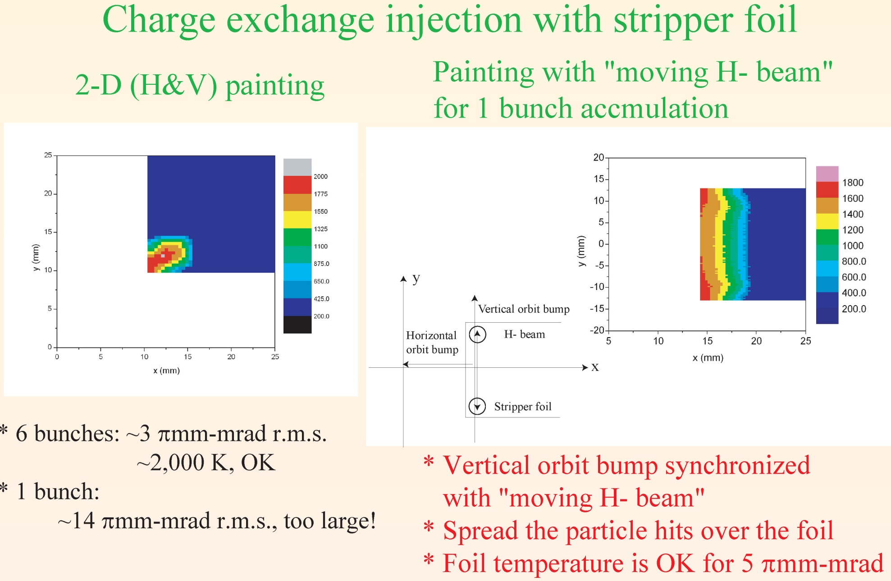
Charge exchange injection
from M. Aiba

Slide 29
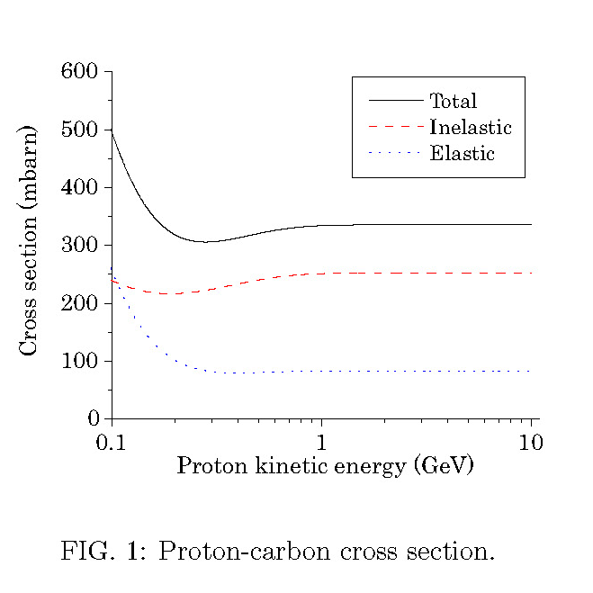
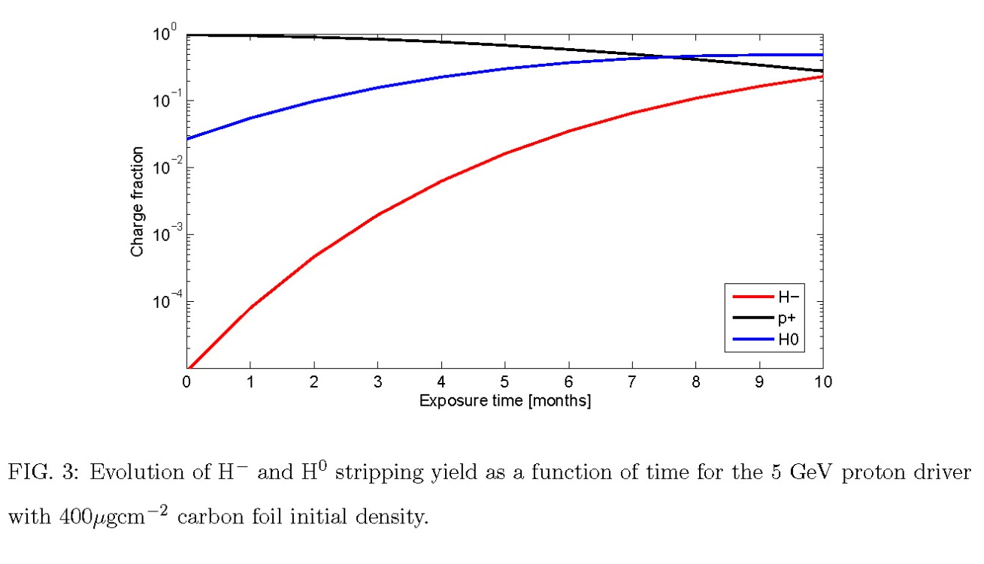
Foil lifetime
From M. Aiba
Inelastic scattering results in permanent damage to the foil
… with the proposed model, foil lifetime is ~6 times lower than estimated
with elastic scattering only !
Need to actively develop laser-based stripping
Need to pursue the analysis and improve the model

Slide 30


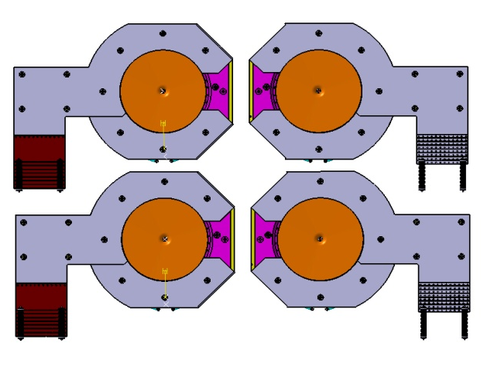
Beam delivery on 4 targets & horns
E. Bouquerel – IPHC, EUROnu meeting, March 27, 2012
side view
Magnetic field (T)
Angle of deflection (rad)
>>KEY PARAMETER<<
2000mm
Kinetic energy
(GeV)
T1
T2
3D view
Magnetic length (m)
Principle:
z
Use of 2 bipolar kickers (or bipolar pulsed magnets): ± 45˚ rotation wrt the z axis
K1 (K2) deflects to D1 and D3 (D2 and D4)
Need of 1 compensating dipole per beam line (1 angle for each target):
  Apply a symmetry in the system
T4
T3

Slide 31
Collective effects [1/6]
From E. Benedetto
6-bunches scenario (the CERN baseline)
  Accumulator ring
        Isochronous (η=0), no RF, ~400μs, beam frozen longitudinally to preserve Δp/p
        6 bunches, 120 ns total bunch length
  Compressor ring
        rapid phase rotation in ~36μs, strong RF, large slippage factor η
        ~2ns rms bunch length @ extraction to the Target
Fast (τ<400μs) instabilities may arise in accumulator
No synchrotron motion to stabilize
Collective effects studies aim at:
  quantifying the risk of instabilities
  finding cures
  setting limits to the machine impedance

Slide 32
Collective effects [2/6]
From E. Benedetto
EM interactions of the beam with the environment
→ wake-fields(t) & impedances(ω)
In the transverse plane:
  Resistive wall (beam pipe finite resistivity)
  Narrow-band resonators (RF cavities, cavity-like objects)
  Broad-Band (BB) resonator (beam-pipe discontinuities)
  Electron cloud
In the longitudinal plane:
  Narrow-band resonators (RF cavities,…)
  BB resonator (kickers & other discontin)
Mainly single-bunch
(since neglecting narrow-band)
PESSIMISTIC analysis:
  → assumed full intensity, while:
  → accumulation (400 μs): intensity going from 0 →max

Slide 33
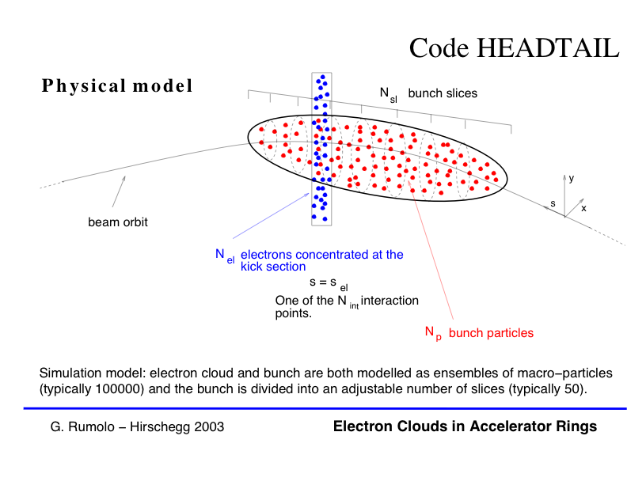
Collective effects [3/6]
Analytical estimations & simulations
HEADTAIL: macroparticles code
From E. Benedetto
  Impedance localized @ few positions
    transfer matrix to the next one
  Bunch sliced longitudinally
  Each slice interacts w. impedance:
    leaves a wake-field behind
    gets a kick
Localized impedance source
→ G.Rumolo, F.Zimmermann, CERN-SL-Note-2002-036-AP
→ D.Quatraro, G.Rumolo et al., Proceedings PAC’09

Slide 34
Collective effects [4/6]
Accumulator parameters designed to match:
  SPL incoming beam
  Compressor requirements
    for time-structure @ target
From E. Benedetto
→ M. Aiba, CERN-AB-2008-060 BI
Transverse emittance (not normalized)
3 π mm mrad:
→ beam size @ target
→ space-charge
→ injection foil heating
Bunch length 120ns & energy spread ±5 MeV → structure @ target
-
Flat bunch with smooth edges → longitud SC

Slide 35
Collective effects: conclusions [5/6]
From E. Benedetto
The 6-bunch option is under control
Space Charge → OK! it guided in definition of emittance & bunch length/shape in the design
Machine impedance:
  narrow-band component → negligible (no RF-cavities)
  resistive wall → not an issue (long risetime)
  longitudinal BB → Z_{l}/n < 4 Ω + error-bar (f_{R}) (~few Ohm easily achieved in modern machines)
  transverse BB → OK! fast rising instability cured by ΔQ (chromaticity (|ξ|~ 1.3) or octupoles)

Slide 36
Collective effects: conclusions [6/6]
From E. Benedetto
  transverse BB
    need ΔQ ~ 0.02, → ok for tune footprint/ resonance
    assumed R_{t}=1MΩ/m → Scaling laws with higher value of BB impedance
  e-cloud → not an issue (flat & long bunch → no multipacting)
3-bunches option as well seems feasible

Slide 37
Status of the SPL
Low energy ν Superbeam option
Pending issues & synergies with ESSnuSB

Slide 38
Comparison ESSnuSB vs SPL-based setup
H- generation
H- stripping
Collective effects in accumulator
Beam loss
Stress on target
 | SPL | ESSnuSB
Beam power | 4 MW | 5 MW
Beam energy | 5 GeV | 2 GeV
Repetition rate | 50 Hz | 14 Hz
Nb. of protons/pulse | 10¹⁴ | 1.1 10 ¹⁵
Linac pulse length | 0.4 ms | 2.86 ms
Lower energy & smaller rep. rate
=> 11 x protons/pulse
Smaller rep. rate, similar linac current &
11 x protons/pulse
=> Much longer pulse length
Linac rep. rate and duty factor
Collective effects in accumulator

Slide 39
Key pending issues
Generic interest for the accelerator community
Linac
  H- ion source
  Beam loss management
  High power RF equipment (power supplies/modulators, Couplers…)
  Field stability in cavities (mechanical vibrations)
  Water and cryogenics cooling infrastructure
  Electrical infrastructure
  Radioprotection
Accumulator
  H- stripping
  Collective effects
  Beam loss management
  Radioprotection
Target
  Design for 360 kJ/pulse
Within reach of on-going SPL coupler development
Generic interest: advanced development at CERN
ESS specific
Generic interest for the accelerator community
ESS specific
ESS specific

Slide 40
Summary
Linac4 in construction. Fully operational at the end 2016.
R&D for the SPL is continuing, focused on design, construction and test of four β=1 cavities in a short cryo-module:
  Design and development of “cheap” high power couplers (8 built; 4 successfully tested today).
  Extensive investment for superconducting cavities fabrication and test (e-beam welding machine, ep bench, optical bench…)
  2 five-cell copper cavities, one bulk-niobium monocell produced,
  4 five-cell bulk Niobium manufactured by industry (RI),
  One five-cell bulk Niobium in fabrication at CERN with an R&D approach,
  Equipment for testing at high RF power (704 MHz) a string of 4 cavities cooled at 2 K in SM18
Potential future work in synergy with ESSnuSB:
  H- source (Linac4 performance and long term interest)
  Field stability in superconducting cavities (combination experiment / simulation)
  H- stripping (long term interest)

Slide 41

THANK YOU
FOR YOUR ATTENTION!

Slide 42
ν applications of the SPL

Slide 43
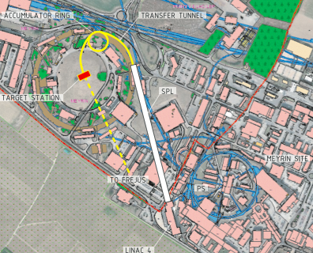
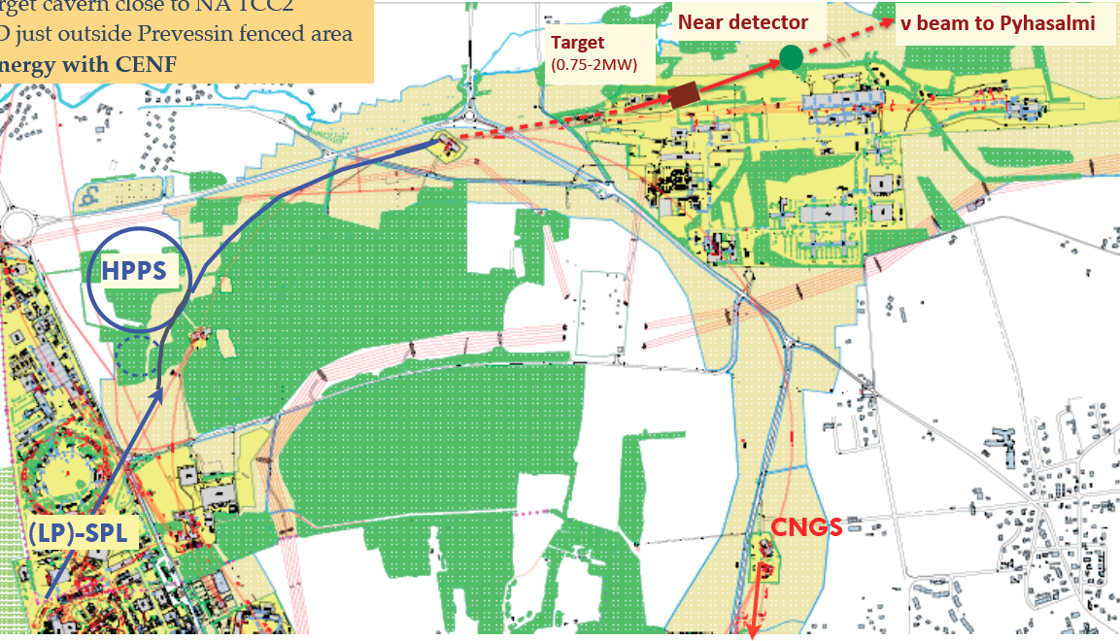
SPL-based proton driver for ν physics
Conventional Superbeams
Low energy ν beam
Medium energy ν beam
Accumulation of HP-SPL beam in a fixed energy Accumulator
(4-5 GeV, 4MW beam power)
Fast ejection onto target(s)
LP-SPL as 4 GeV injector of a High Power 50 GeV synchrotron
(50 GeV, 2 MW beam power)
Phase 1: SPS (400 GeV -700 kW)
Phase 2: HP-PS (50 GeV – 2 MW)

Slide 44
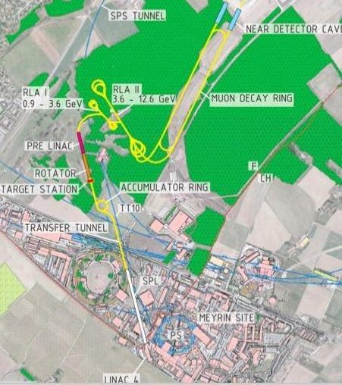
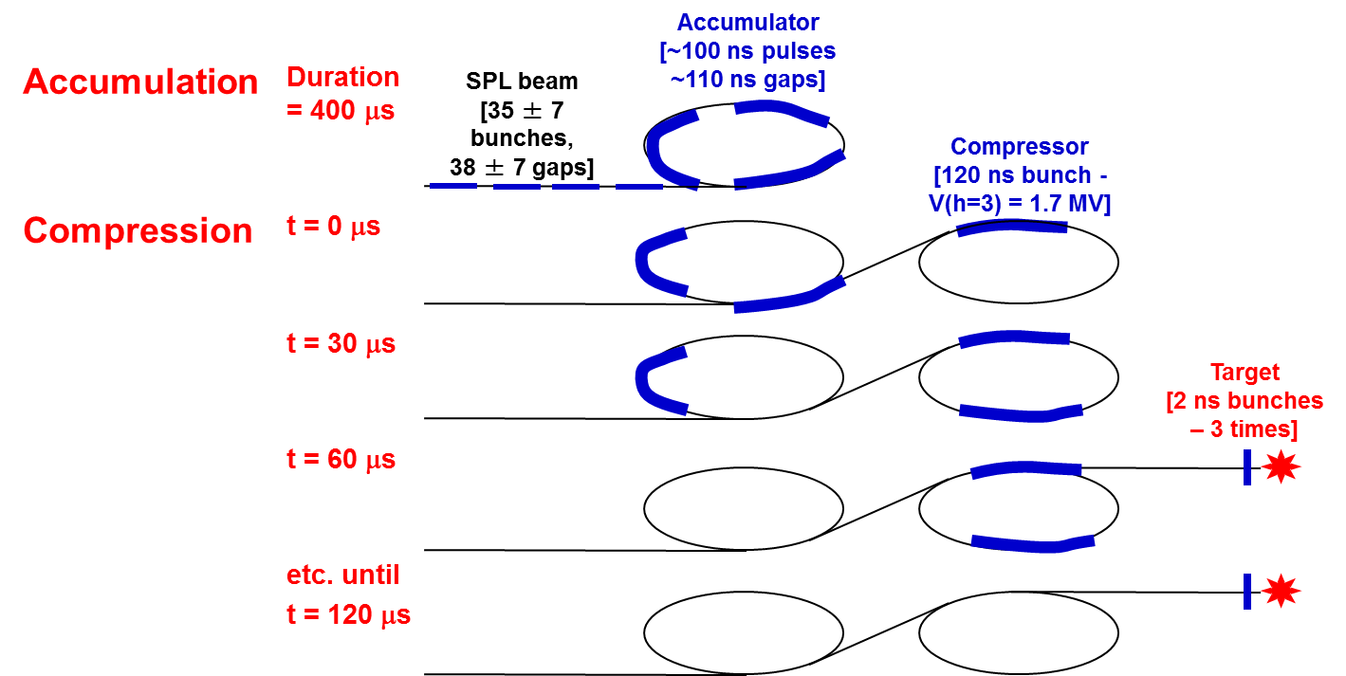
SPL-based proton driver for ν physics
Neutrino Factory
Accumulation of beam from the High Power SPL in a fixed energy Accumulator (4-5 GeV, 4MW)
Bunch compression («rotation») in a separate Compressor ring
Fast ejection of few (3-6) short (2 ns) bunches to target

