Slide 1

Current situation of ESSνSB and
Status of WP1 Management
Tord Ekelof, Uppsala University

Slide 2
Reminder of the situation before 2012 at which time LBNE, Hyper-K and LBNO were designed – the optimum for CP violation discovery was clearly at the first maximum
Θ₁₃=4º
1st osc. max 2nd osc. max 3rd osc. max

Slide 3
After the spring 2012, when Θ₁₃ had been measured and ESSnuSB was
designed, CP violation discovery probability did not increased at the first
maximum – at the second maximum it however increased drastically and
became significantly higher than at the first
Θ₁₃=8.73º
1st osc. max 2nd osc. max 3rd osc. max

Slide 4
Comparison of ESSnuSB with LBNE and Hyper-K
As the proton drivers of LBNE and Hyper-K both have significantly less power than the 5 MW of the ESS linac, it is not possible for these to experiments to reach the second oscillation maximum – statistics becomes too poor.
It is thus not only that the location of the detectors of LBNE and HyperK need to be in the Pacific Ocean and the Japanese Sea, respectively, to be at the second oscillation maximum - which is clearly a difficulty in itself - but even if this could be made so, the proton drivers foreseen for these experiments do not have enough power to provide sufficient statistics at the far second maximum.
Conversely, remaining at the first maximum with the detectors, there is not much point (for CP violation discovery) in much increasing the power of the LBNE and Hyper-K since the statistical error is already smaller than the systematic error at the first maximum of these experiments.
P5 published its recommendations on, inter alia, the US neutrino program last Thursday – to be reviewed by Jim Strait at 17.10 today.
Hyper-K will have its next Collaboration Meeting 19-10 July at TRIUMF, Canada

Slide 5
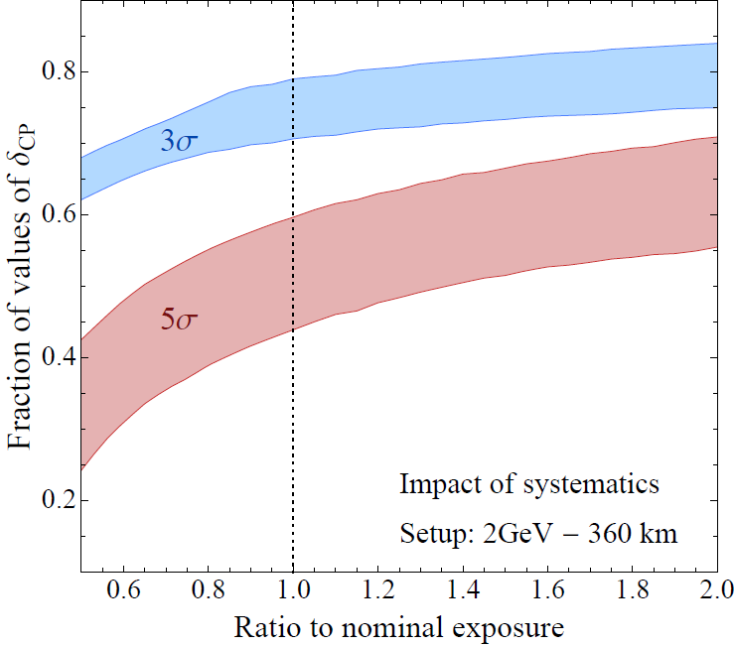
So, ESSnuSB is designed to balance the statistical errors collected in 10 years at the second maximum with the systematic errors.This, naturally, means that if the 5 MW would not be reached the CP discovery potential will decreased. The plot below shows by how much. a decrease of the linac power from 5 to 2.5 MW would reduce the δ_{CP} 5σ discovery range from 59% to 43%. To cpme bach to 59% one would have to run for 20 years. Running for 20 years with 5 MW reaches the same coverage as the Neutrino Factory, 72%.
Neutrino
Factory
ESSnuSB systematic errors:
Signal/ Background
Upper border 5%/10%
Lower border 10%/15%
ESSnuSB signal statistics
in 10 years is order of 400
events implying a statistical
error of about 5%

Slide 6
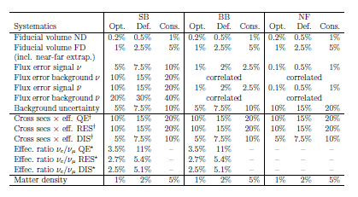
Errors used in simulations by Pilar Coloma et al arXiv:1209.5973

Slide 7
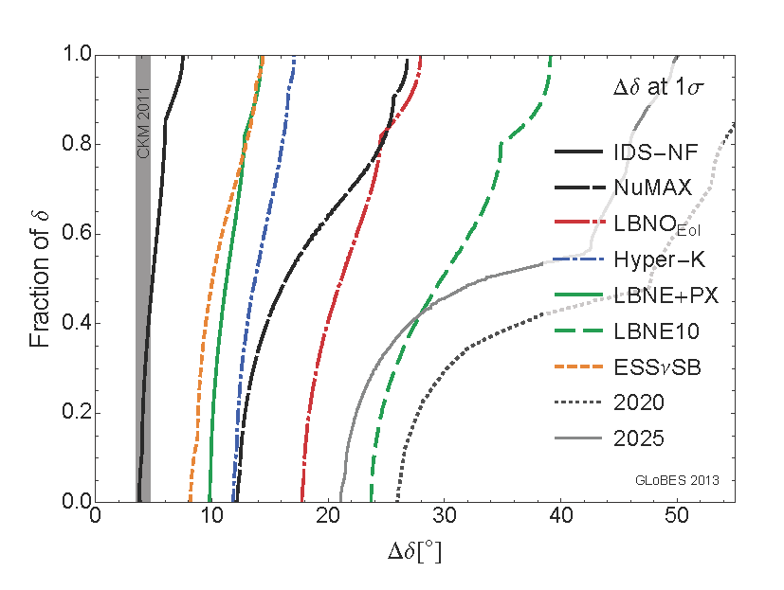
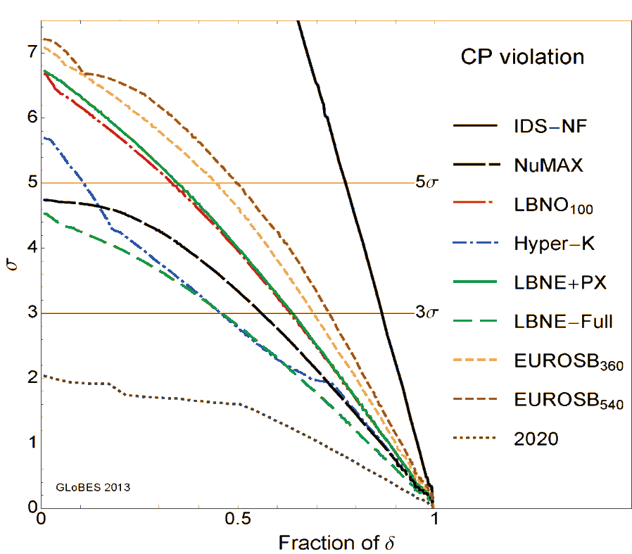
Message from DFT of APS, dated 19 May 2014:
“The Proceedings of the 2013 Community Summer Study (Snowmass 2013) have now been published in their permanent location on SLAC's eConf service. You can find them at the following web site: http://www.slac.stanford.edu/econf/C1307292/”
In chapter “Neutrinos, page 34, the δ_{CP} measurement precision plot in the left panel is shown. A small difference in Δδ_{CP} makes the large difference in CP violation discovery reach, shown in the right panel.
ESSnuSB proposal arXiv:1309.7022 accepted for publication in Nuclear Physics B

Slide 8
Research and Innovation actions
Innovation actions
Design Study
H2020-INFRADEV-1-2014-1
Title of Proposal: Discovery and measurement of leptonic CP violation using an intensive
neutrino Super Beam generated with the exceptionally powerful ESS linear accelerator
Acronym of Proposal: ESSnuSB
List of participants
Participant no. | Participant organisation name | Part. short name | Country
1 (Coordinator) | Centre National de la Recherche Scientifique | CNRS | France
2 | Uppsala Universitet | UU | Sweden
3 | European Spallation Source | ESS | Sweden
4 | European Organisation for Nuclear Research | CERN | IEIO
5 | Sofia University St. Kliment Ohridski | UniSofia | Bulgaria
6 | Istituto Nazionale di Fisica Nucleare | INFN | Italy
7 | Cracow University of Technology | CUT | Poland
8 | Universidad Autonoma de Madrid | UAM | Spain
9 | KTH Royal Institute of Technology | KTH | Sweden
10 | Lund University | LU | Sweden
11 | Science and Technology Facilities Council | STFC | UK

Slide 9
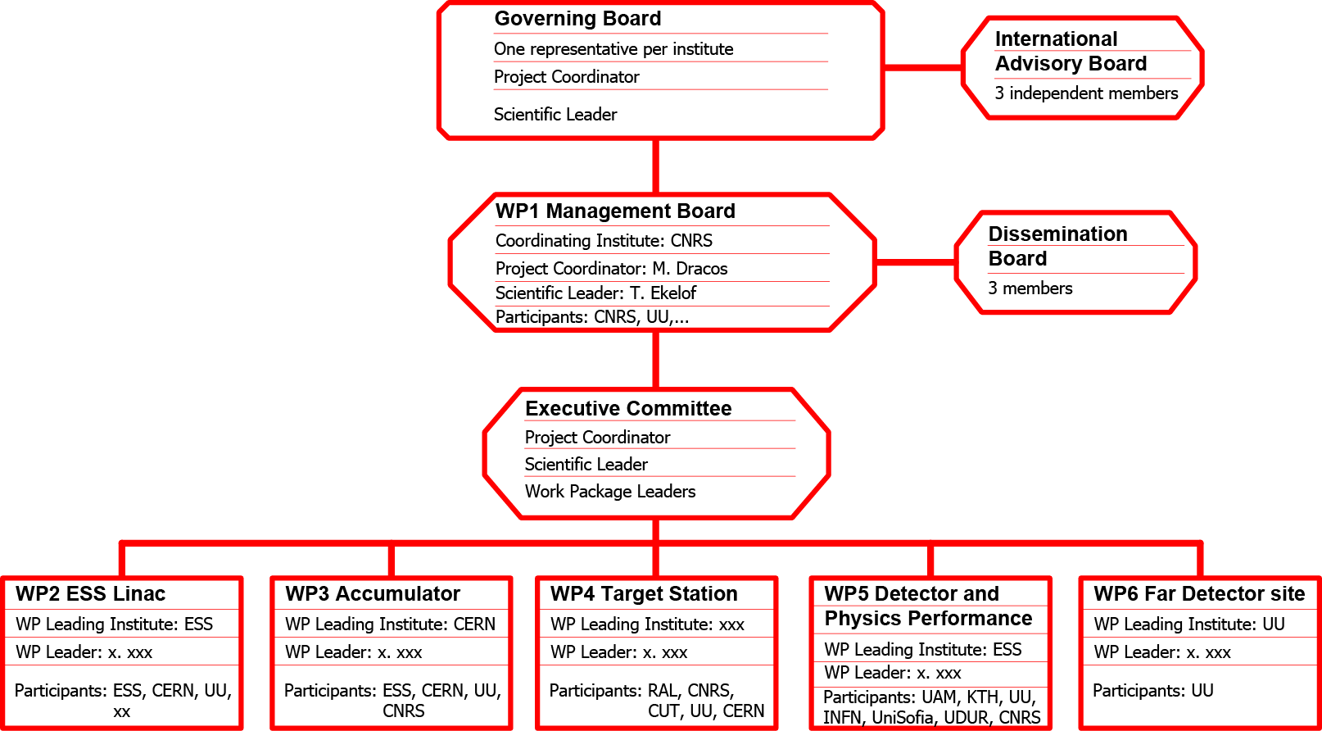
ESSnuSB Management Structure
CRNS
cr

Slide 10
Cunceptual Design Report

Slide 11
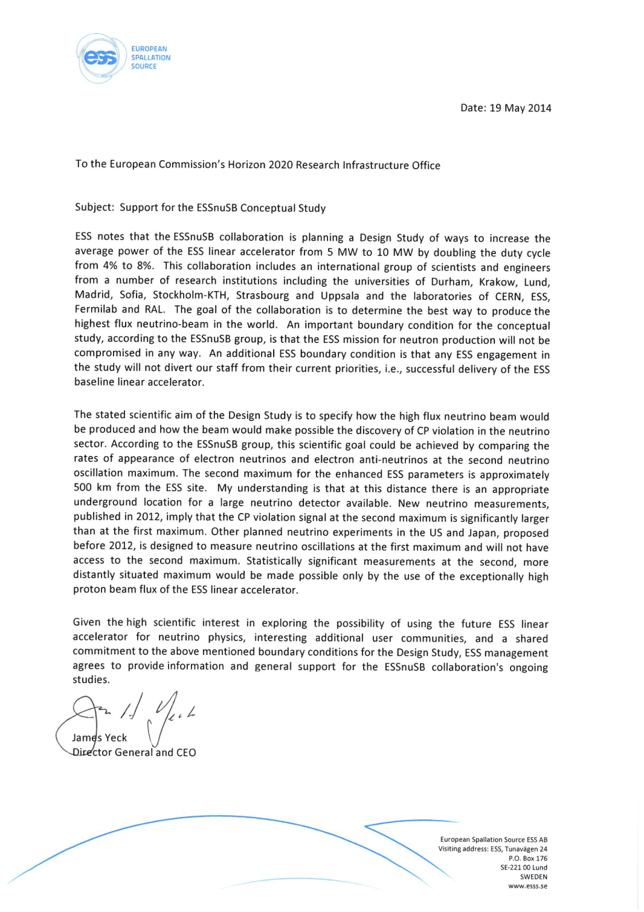
Expression of support
to ESSnuSB
by the ESS Management

Slide 12
On 5/19/2014 1:34 PM, Tord Ekelöf wrote:
Dear Frédérick,
ESSnuSB has made a request to CERN to assist in the work to evaluate what modifications have to be made to the current base-line ESS linac design. …
The first critical step in this evaluation is to identify which are the minimal modifications to the current ESS linac design, that would be needed to avoid that a later upgrade for concurrent neutrino beam production will imply a major modification of the base-line construction, the aim being to avoid the need for major dislocation of existing equipment and longer shut-downs, once the upgrade is to be made. This problem does not change much if we, according our basic plan, will make the upgrade concurrently with the build-up of the linac 2017-2023, but we need to also cover the case that the upgrade will start during, or after the conclusion of, the ESS base-line linac build-up.
It is to make a first identification of these minimal modifications that we ask that CERN experts visit ESS in Lund, Sweden during a few days. We have already assured that the CERN experts would be received by ESS accelerator experts, who will provide access to all relevant technical information and spend sufficient time to discuss the issues with the CERN experts. Our contact with ESS has been Elena Wildner, who has produced the enclosed working note, listing the ESS linac system components that need to be upgraded to enable the generation of an ESSnuSB neutrino Super Beam. As mentioned in this list, Elena has discussed it with Erk Jensen, who has proposed Frank Gerijk and Erik Montesinos as the CERN experts to visit ESS during 4 days. She has also discussed the items on the list with Mamad Eshraqi of the ESS Accelerator Division.
The primary aim of the visit we here ask for is to identify the minimal modifications required to the ESS linac system as described. ESSnuSB will soon need to request the approval by the ESS Management of the modifications that need to be made and how they shall be realized….
Best regards,
Tord
----------------------------------------------------------------------------------------------------------------------------------------------------------------------------------------------
On 5/24/2014 5:29 PM, Frederick Bordry wrote:
Dear Tord, I discussed with Erk and we agree to the visit of Eric and Franck for 4 days with the condition to define the right date to not have interference with the restart of the CERN accelerators.
We assume that the financing of their travel and their stay will be covered by ESS and/or Upsala University.
Best regards
Frédérick
Expert support to ESSnuSB provided from CERN

Slide 13
Evaluation review of ESSnuSB provided by the of European Steering Group for Accelerator R&D (ESGARD)
Oral ESSnuSB status reports given to ESGARD at its meetings 2014-11-19 at CERN and 2014-05-22 at DESY
Draft Agenda of the ESGARD meeting 22 May 2014 at DESY
9:30 Welcome, approval of agenda and minutes and introduction
10:05 European Strategy for Particle Physics and its implementation
• FCC Design Study (M. Benedikt, 30mn)
• Discussion (All)
11:30 European Strategy for Particle Physics and its implementation
• Design study of intense ν-beams (T. Ekelof, 30mn)
• Discussion (All)
13:30 Plasma Acceleration
• 13:30 : Proposal for DS (R. Assmann,30mn)
• 14:00 : Discussion (All)
• 14:30: FET Projects (R. Assmann,30mn)
• 15:00 : Discussion (All)
15:30 Overall discussions on the presented projects
15:45 AOB

Slide 14
ESSnuSB report to be given at International Meeting for Large Neutrino Infrastructures at APC in Paris 23-24 June
23 June 2014
Welcome, meeting goals - (09:00-09:15)- KATSANEVAS, Stavros
Analysis of oscillation parameters: 2014 status - (09:15-09:45)- LISI, E
US-beam plans - (09:45-10:05) - STRAIT, J
European beam plans - (10:05-10:30)- M, Nessi
Japanese plans - (10:30-10:40)- KOBAYASHI, T
Current program and projections (Reactors, T2K, NOVA) - (11:00-13:30) - AGARWALLA, SK
LBNE - (11:30-12:00) - DIWAN, M
LAGUNA-LBNO - (12:00-12:30)- RUBBIA, A
HK - (12:30-13:00) - SHIOZAWA, M
ESS - (13:00-13:30) - EKELOF, T
Short-Baseline sterile neutrino program - (14:30-15:00)
ICFA report - (15:00-15:30) - LONG, K
P5 Report - (15:30-16:00) - RITZ, S
Roundtable - Amphitheatre (16:30-17:30)
Cocktail reception - Amphitheatre (18:00-21:30)
Agency closed meeting - Amphitheatre (19:00-22:00)
24 June
Theory - (09:00-09:30) - SMIRNOV, A
Neutrino number and mass from cosmology - (09:30-10:00) - LESGOURGUES, J
Neutrino mass measurements prospects - (10:00-10:30) - MACDONALD, A
Neutrino measurements needed for systematics - (10:30-11:00) - HUBER, P
Reactor Sterile neutrino program - (11:30-12:00)- LASSERRE, T
Reactor JUNO - (12:00-12:30) - WANG, Y
Reactor RENO-50 - (12:30-13:00)- KIM, SB
INO - (14:30-15:00)- MONDAL, N
PINGU/ORCA - (15:00-15:30) - KOWALSKI, M
Roundtable - Amphitheatre (16:00-17:00)
Agency closed meeting - (17:00-18:00
The aim of the International Meeting for
Large Neutrino Infrastructures (IMLNI) is to
gather key representatives of funding
agencies and key proposers of neutrino
infrastructures from all the regions of the
world to assess the opportunities of global
scale collaborations and eventually set up
the forum and tools for the accompaniment
of the global coordination effort. The meeting
is hosted by the Astroparticle Physics
European Consortium (APPEC) and is
prepared in close contact with large funding
agencies and the ICFA neutrino panel.

Slide 15
Possible funding sources of the Design Study
INFRADEV Design Study
COST travel funds
INFRAIA program "Science at deep-underground laboratories"
National Research Funding Authorities infrastructures programs
EC Structural Funds Garpeneberg mine and socio-economic development
The collaborating institutes manpower, computing, equipment
In Sweden Consultations are being made with
(dates indicate meetings closest in time)
Swedish Ministry of Research (17 June 2014 with Allan Larsson)
NordForsk (Nordic ESFRI meeting 7 May 2014)
Swedish Structural Funds Authority (8 May 2014)
Garpenberg Mine Management (16 June 2014)
Garpeneberg Local Authorities (16 June 2014)
Japanese Embassy and JSPS (11 June)

Slide 16
2nd ESSnuSB Open Meeting
26-27 May at CERN, IT Auditorium Bat 31-3-004 https://indico.in2p3.fr/conferenceTimeTable.py?confId=10090
Monday 26May 2014
Welcome (14:00-14:10) Prof. BERTOLUCCI, Sergio
Current situation of ESSnuSB and status of WP1 Management (14:10-14:40)Prof. EKELOF, Tord
Leptonic CP violation and matter/antimatter asymmetry in the Universe (14:40-15:10)Dr. PASCOLI, Silvia
WP4 The Target Station(15:10-15:30) Dr. VASSILOPOULOS, Nikolaos
The ESSnuSB target(15:30-15:50) Dr. DENSHAM, Cris
A Solenoid Hadron Collector(15:50-16:00) Dr. REMO, Maccaferri
WP5 Detector Cavern (16:00-16:20) Mr. NORLING, Lars
WP3 The Compressor (16:50-17:10) Dr. WILDNER, Elena
Status of the US Long Baseline Neutrino Experiment (LBNE) project (17:10-17:30) Dr. STRAIT, Jim
The CERN Super Proton Linac (SPL) project and ESSnuSB (17:30-17:50) Dr. GAROBY, Roland
The LBNE Water Cherenkov Detector Project (17:50-18:10) Dr. STRAIT, Jim
Open slot for ESGARD (18:10-18:30)
Discussion (18:30-19:00)
Dinner (19:30)
Tuesday 27 May 2014
WP2 The ESS Linac Upgrade (09:00-09:20) Dr. MCGINNIS, David
Tests of the spoke-cavity power upgrade (09:20-09:30) Dr. BOUSSON, Sébastien
Status of the ESSnuSB Design Study application to EC/Horizon2020; deliverables, milestones and funds requested (09:30-10:10) Dr. DRACOS, Marcos
Discussion on the role of each of the participating institutes (10:10-10:40)
Next steps towards the EU Design Study application to be submitted 2 September 2014 (11:10-11:30)
Discussion and Conclusions (11:30-12:00)

Slide 17
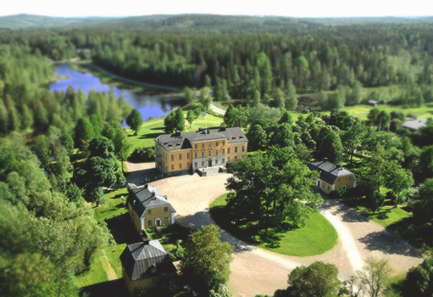

Thank you for your attention
Garpenberg Castle
17

