Slide 1
E/p v.s. time
Does ECAL change?
Jie Feng

Slide 2
selection
Sample: 20~80 GeV electron, proton and helium
Period: 07.11 – 11.13 (29 months)
Reconstructed energy: EnergyE, EnergyA, EnergyD

Slide 3
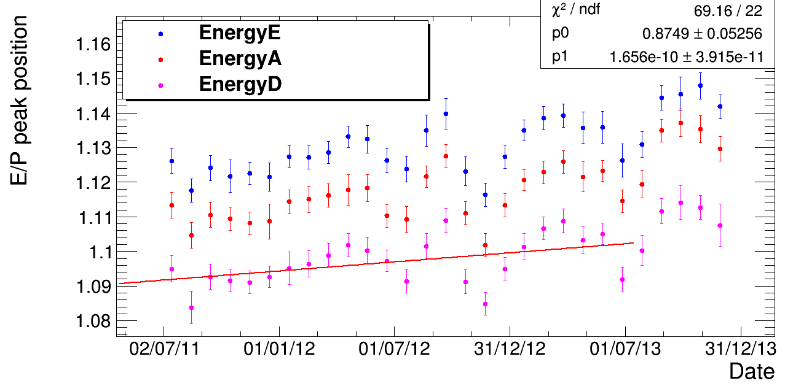
Electron E/p position
2% increase of E/p peak position during this two years is observed for all kinds of reconstructed energy.
Something has changed after 07.13.

Slide 4
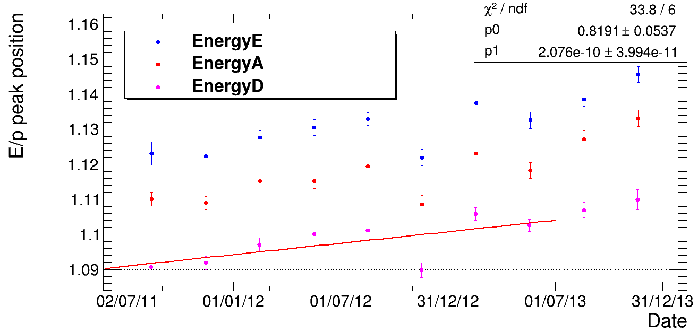
Electron E/p position – 3 months / point
2% increase of E/p peak position during this two years is observed for all kinds of reconstructed energy.
The change after 07.13 is smoothed.

Slide 5
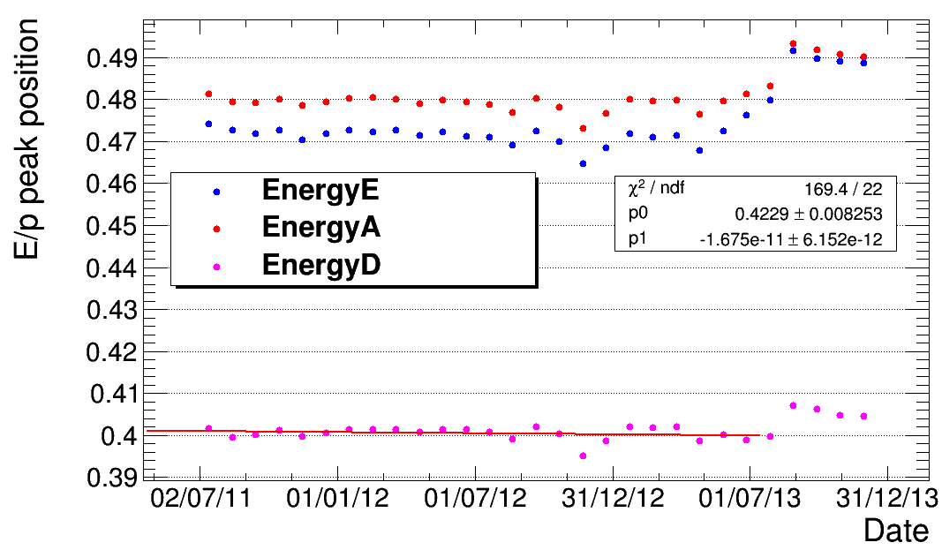
Proton E/p position – (1)
Proton E/p peak position is quite stable with time, especially for EnergyD
The step around 07.13 may be due to the update of Ecal calibration.

Slide 6
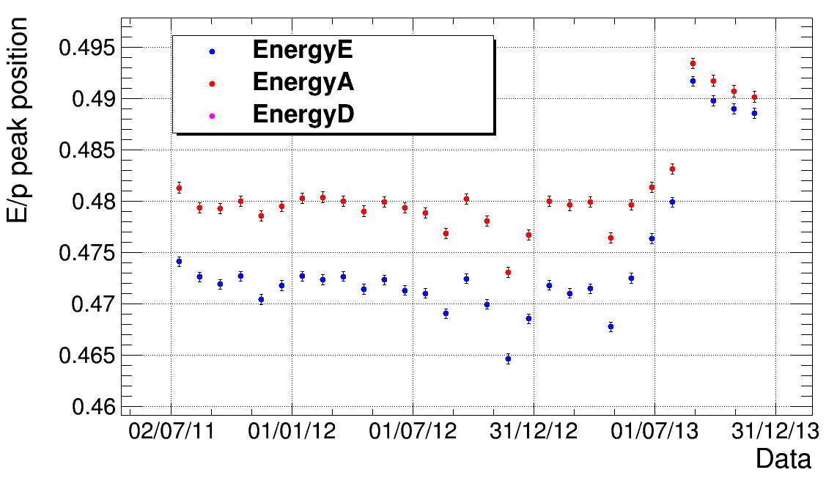
Proton E/p position – (2)
Proton E/p peak position is quite stable with time.
The step around 07.13 may be due to the update of Ecal calibration.

Slide 7
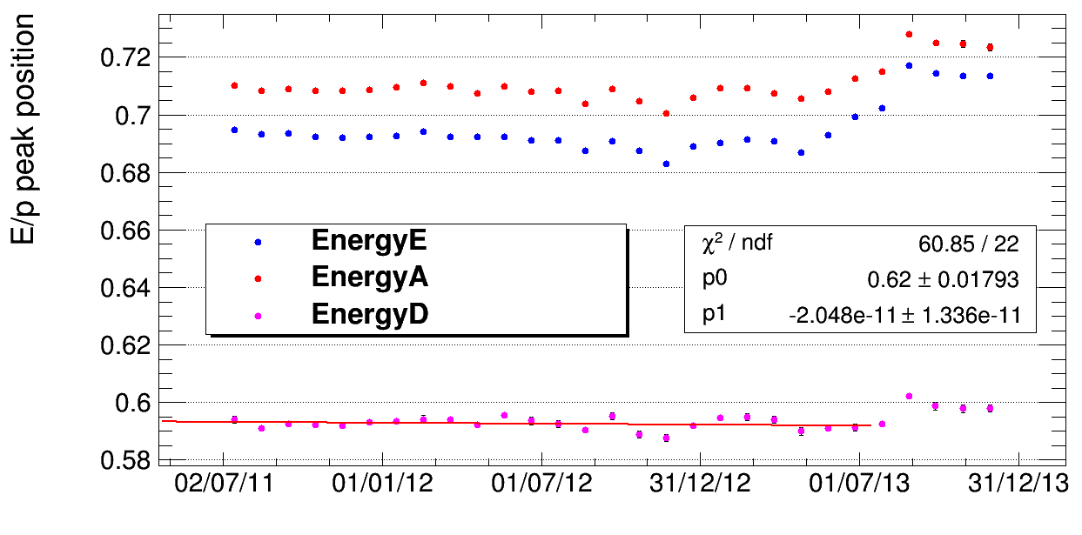
Helium E/p position – (1)
Helium E/p peak position is quite stable with time, especially for EnergyD
The step around 07.13 may be due to the update of Ecal calibration.

Slide 8
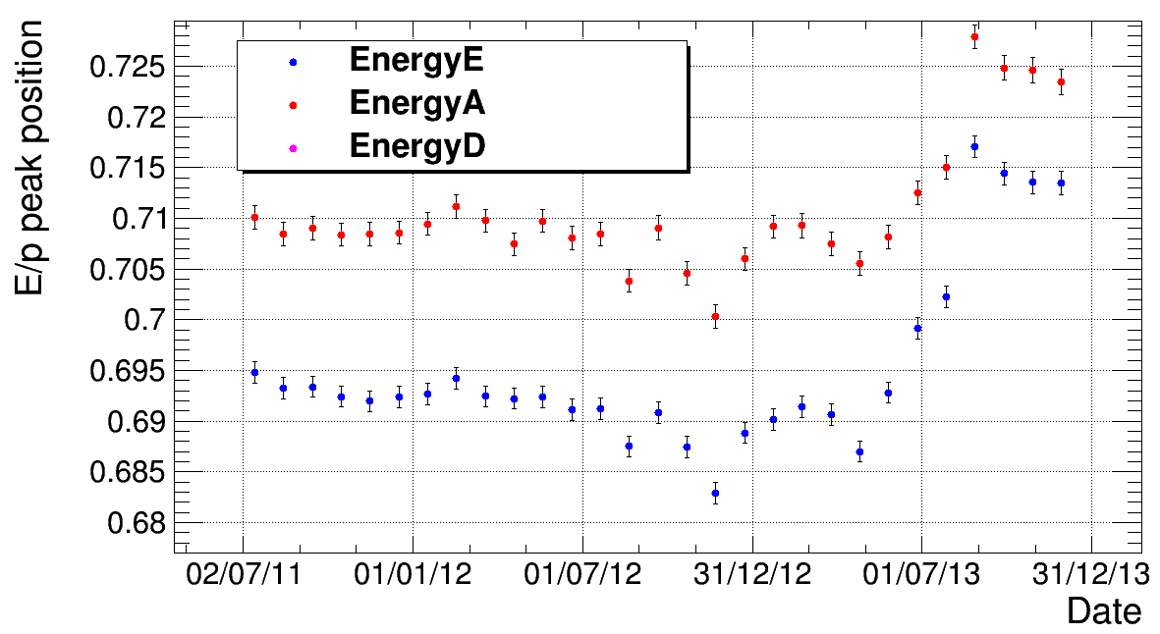
Helium E/p position – (2)
Helium E/p peak position is quite stable with time.
The step around 07.13 may be due to the update of Ecal calibration.

Slide 9
Summary
Before 07.13：
E/p of electron increases with time.
E/p of hadron does not increase with time.

Slide 10
Potential Reasons
Ecal performance difference between EM showers and hadronic showers.
Reconstructed rigidity difference between that of electron and that of hadron.
The largest difference between electron and helium is the mass.
Synchrotron radiation?

Slide 11
To do
Check the mass of Helium v.s. time to check rigidity.
Rig_L1/Rig_L9 v.s. time to see electron radiation.

Slide 12
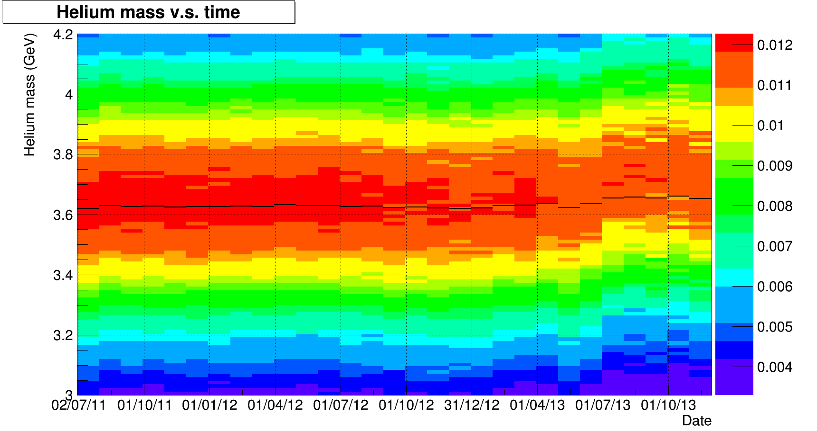

Helium mass with time
8~10 GV Helium are selected.
Beta is measured by RICH.
Mass is stable before 07.13. Something has changed since 07.13.
The peak shifts by 3% at around 07.13.
$$m=\frac{rigidity∗Z}{β∗γ}$$

Slide 13
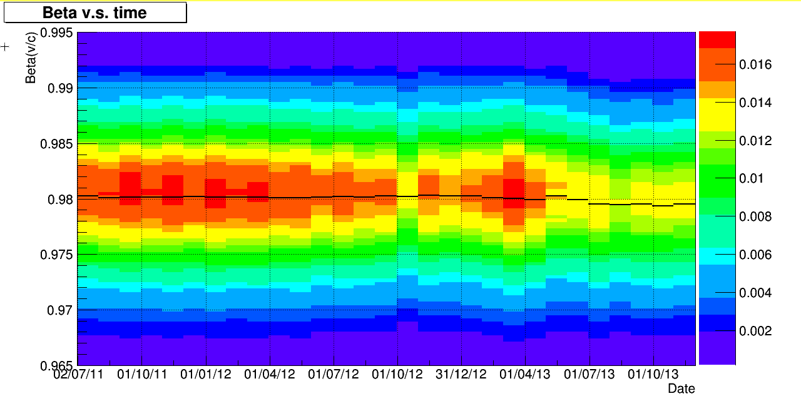
Beta with time
8~10 GV/c Helium are selected.
Beta is measured by RICH.
β shifts by ~-0.05%, β γ by ~-6% and mass by 3%.
For the same rigidity, this demonstrates that we observes some problem for rigidity or rich.

Slide 14
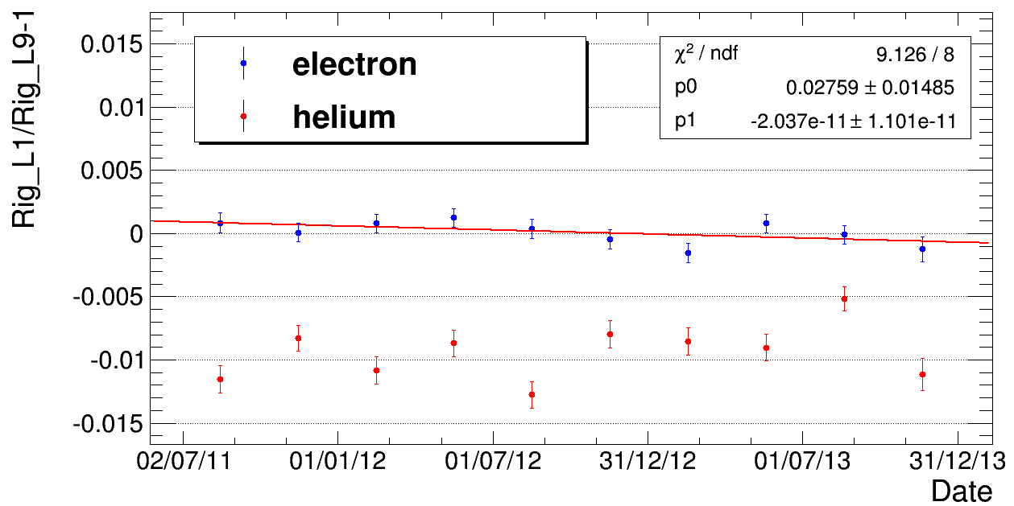
Synchrotron radiation?
Rigidity_L1/Rigidity_L9-1 does not describe the increase of the synchrotron radiation.

Slide 15

Conclusion
Before 07/13:
Helium mass ➔rigidity stable with time
➔ECAL is stable with time
EnergyD/p of helium
After 07/13:
Something unknown has happened:
1) ECAL equalization change?
2) Tracker or RICH change?

Slide 16
Back up slides

Slide 17
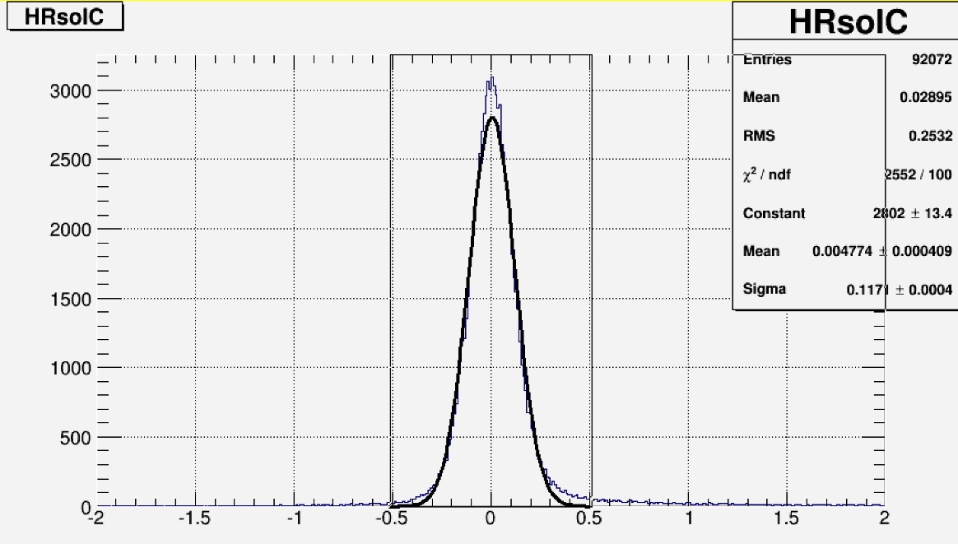
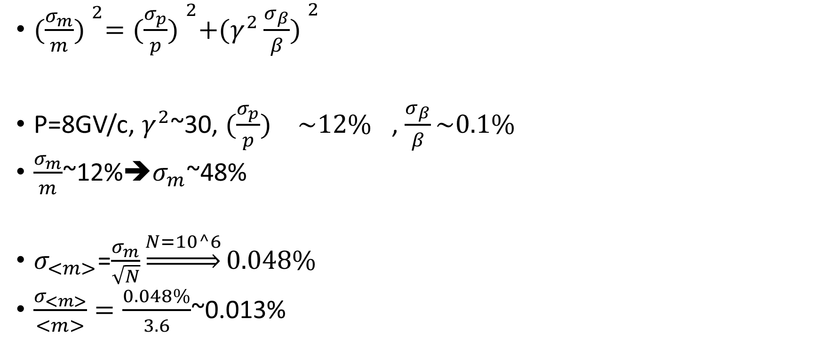
Possibility to measure the rigidity performance with Helium mass.
-Discussion with F.Barao
${(\frac{σ_{m}}{m}) }^{2}={(\frac{σ_{p}}{p}) }^{2}+{(γ^{2}\frac{σ_{β}}{β}) }^{2}$
P=8GV/c, $γ^{2}$~30, ${(\frac{σ_{p}}{p}) }^{}\sim {12\%}^{}$, $\frac{σ_{β}}{β}\sim 0.1\%$
$\frac{σ_{m}}{m}$~12%➔$σ_{m}$~48%
$σ_{<m>}$=$\frac{σ_{m}}{\sqrt{N}}\underset{⇒}{N=10^6}0.048\%$
$\frac{σ_{<m>}}{<m>}=\frac{0.048\%}{3.6}$~0.013%
8GV/c rigidity resolution is 12%. Drawn by H.Chou(Taiwan).

Slide 18
selection

Slide 19
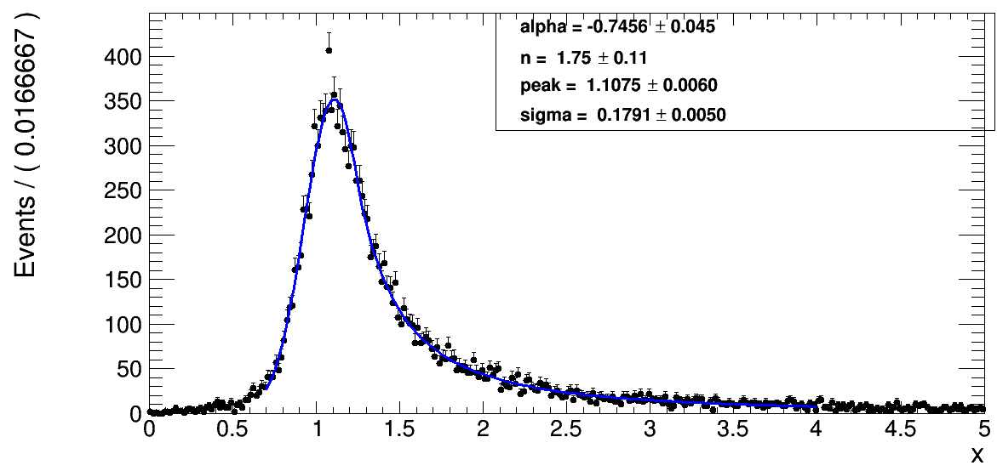
Electron EnegyD fit

Slide 20
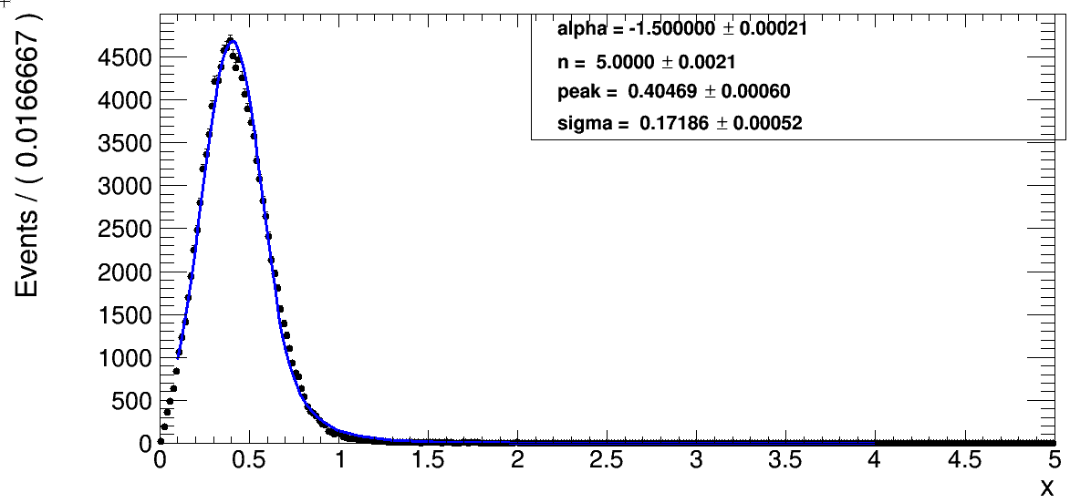
Proton EnegyD fit

Slide 21
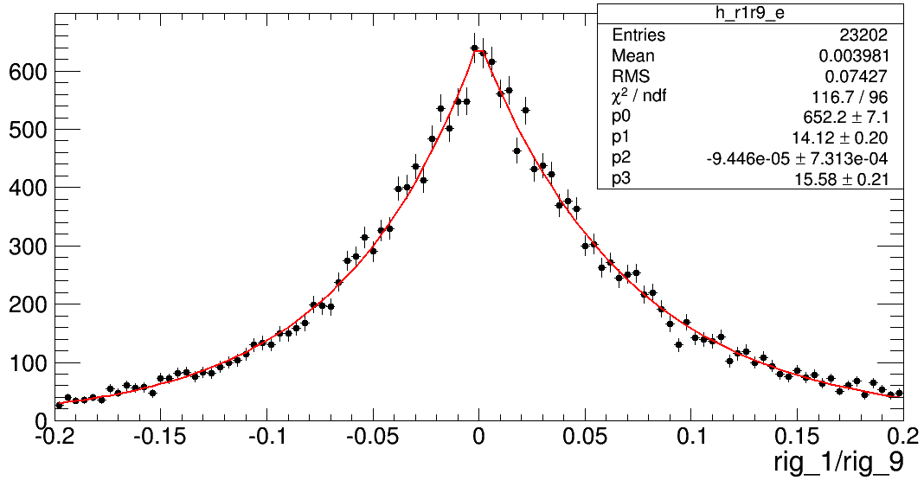
Rig_1/rig_9 for electron

Slide 22
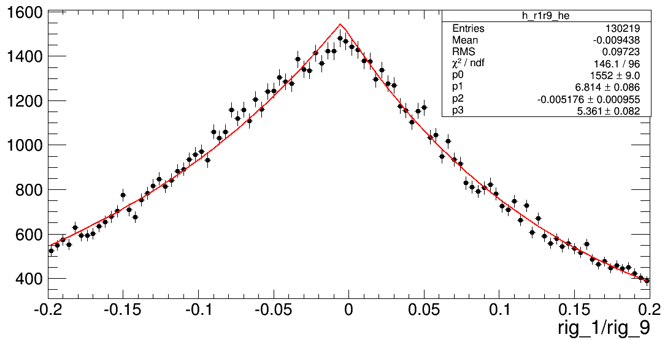
Rig_1/rig_9 for helium

Slide 23
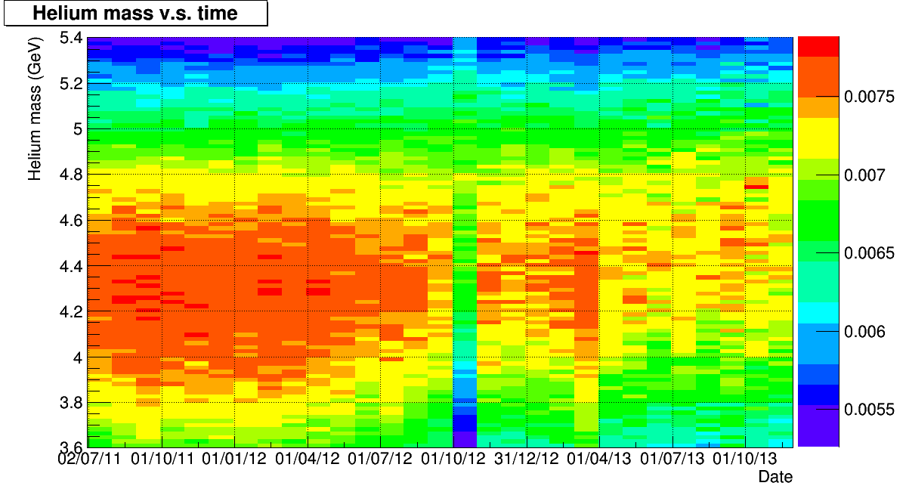
Helium mass measured by TOF
Hard to tell if there is a break at 07.13.

