Slide 1

Top Mass Measurements
@ the Tevatron
CDF
Kirsten Tollefson
Michigan State University
3rd Top Workshop @ Grenoble
Notes:
Good morning. I’m going to talk to you this morning about measuring the mass of the top quark at the Tevatron. I want to apologize before hand to my D0 colleagues. The title of this talk is a bit misleading – you’ll find that it would have been more appropriate to call it Top Mass Measurements at CDF. I will be showing results mainly from CDF but I want to point out that D0 has similar analyzes with similar sensitivities and in fact over the last year the 2 experiments have been working together closely on combining our results.

Slide 2
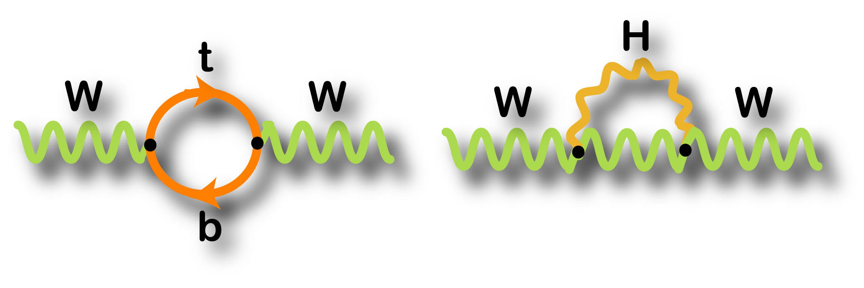
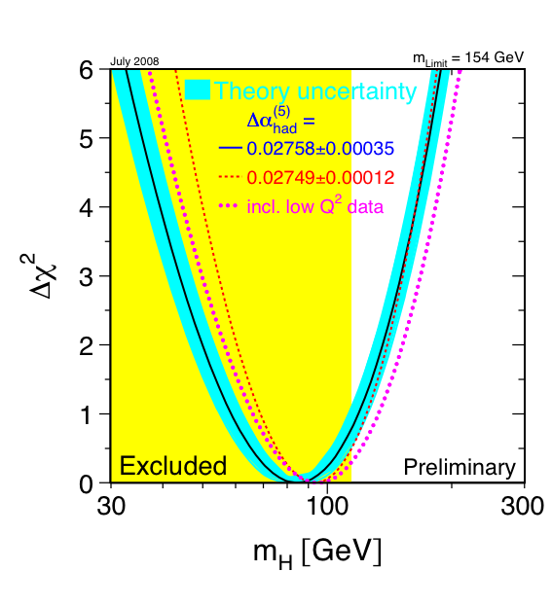
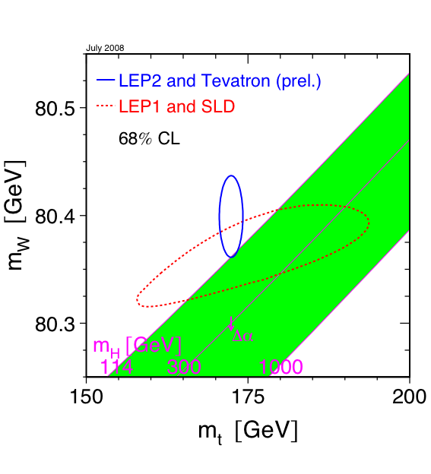
Why Measure the Mass
∝ m_{t}²
∝ ln(m_{H})
July 2008
84+/-30 GeV
Notes:
Since this is a workshop exclusively on Top I assume everyone here is a fan of top quarks so you don’t need motivation to measure one of its fundamental parameters but let me remind you that the top’s mass is important in the loop corrections so here are the latest constraints on the Higgs mass using information from this summer (done for ICHEP). Right plot is chi2 fit to latest EWK parameters assuming SM. Preferred mass is at 84 +/- ~30 GeV with the upper limit at 154 GeV (or 185 GeV if take into account LEP direct limit in yellow).

Slide 3
History
Notes:
Here’s one of my favorite plots. Talk to you today about how we got to a measurement with a 0.7% precision. Special place in my heart for red point here – my thesis result

Slide 4
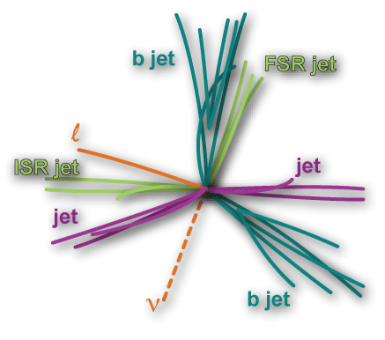
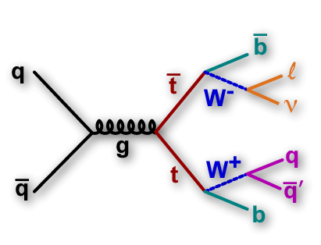
Measuring the Mass ain’t Easy
What a theorist sees…
What an experimentalist sees…
Challenges:
Combinatorics
Jet Energy Scale (JES)
Solutions:
Sophisticated analyses
In-situ W→jj calibration
  (more on this later)
Notes:
Getting to a precision of 1 GeV is not as easy as it looks from the history plot makes it seem.

Slide 5
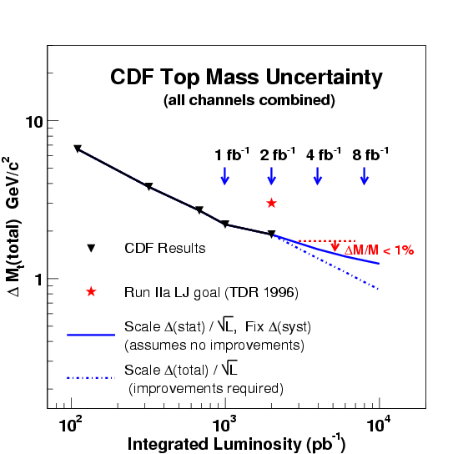
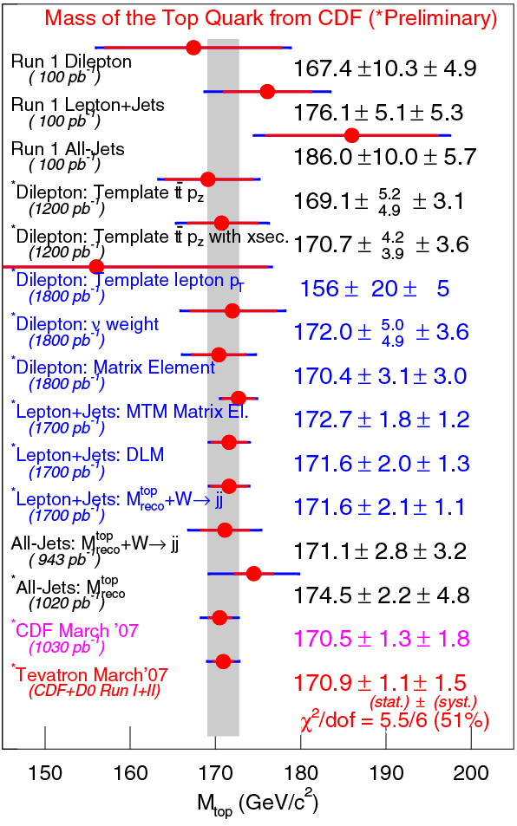
Philosophy in Run II
March 2007
Mtop = 170.9 +/- 1.9 GeV/c²
using up to 2 fb⁻¹
Notes:
Measure the mass in all channels (l+jets, dilepton, all-hadronic) with many different techniques. One wanted to check for differences in mass in channels since in Run I saw dilepton always low and all-had always high. Also started using more sophisticated techniques such as neural networks and matrix elements and wanted to cross check with the more traditional Run I template style analysis. (Only showing CDF plots here but D0 has similar number of results using similar techniques.) One surprise was how much better we are doing in measuring the top mass than anticipated in our Technical Design Reports for Run II (said 3 GeV using 2 fb-1). How did we do so well? Largest systematic was from the jet energy scale…

Slide 6
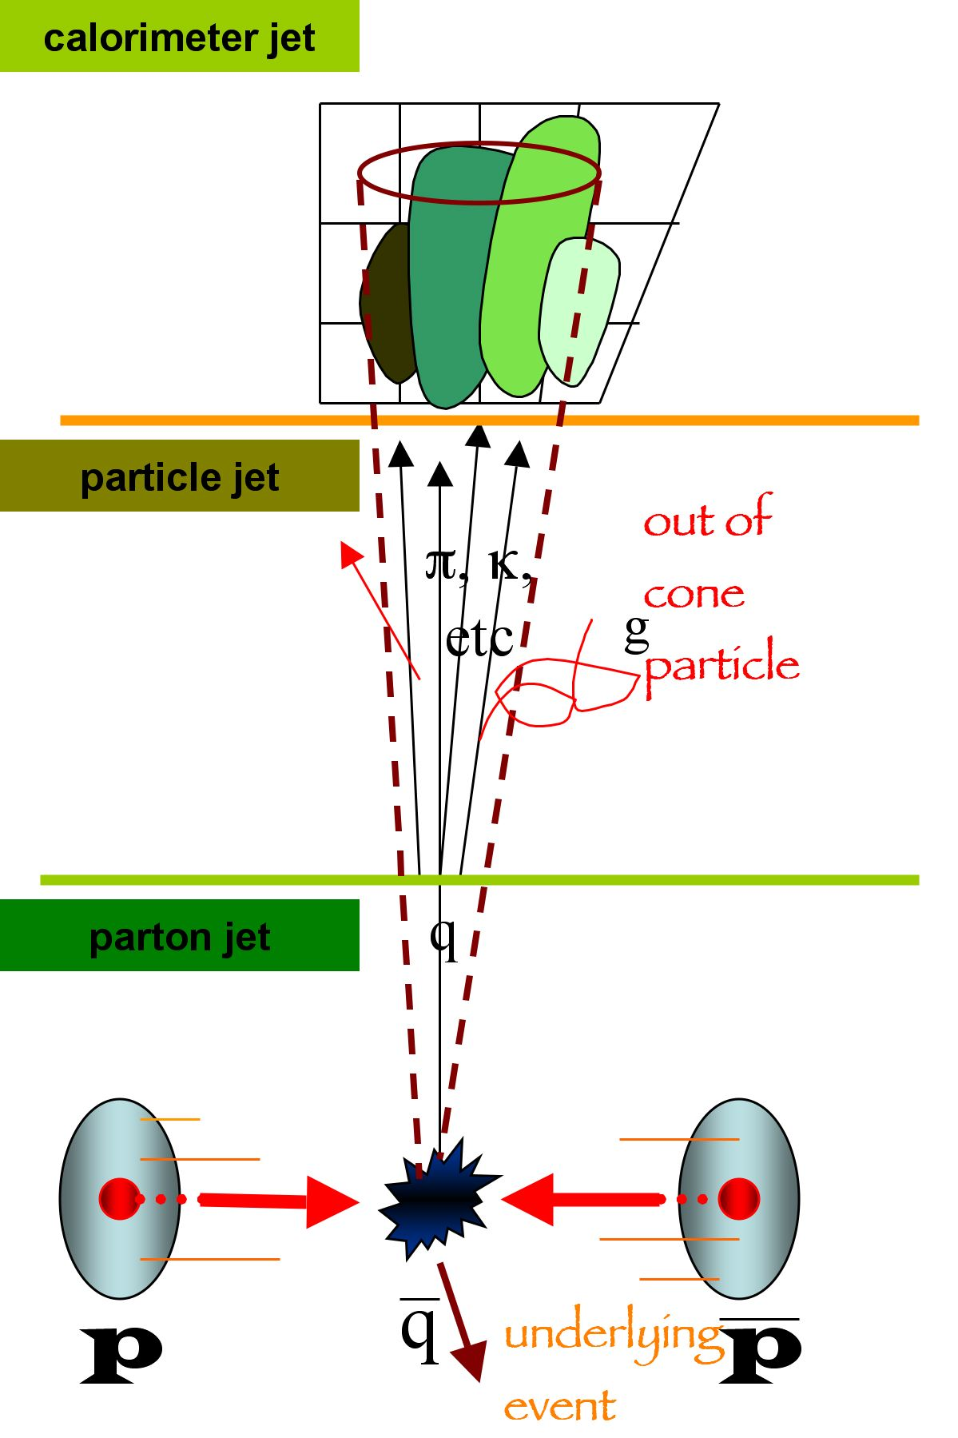
Jet Energy Correction
Jet Energy Scale (JES) Review
Non-uniform
response
Relative using dijet balance: to make response uniform in η
Multiple ppbar interactions: pileup
Diff. response
of π0/πi+-
Non-linearity
Absolute correction using dijet MC tuned for single particle E/P, material, and fragmentations: due to non-linear and non-compensating calorimeter
Shower, fragmentation
Underlying events due to spectators
Out-of-Cone : due to energy outside cone
See M. D’Onofrio’s talk from Thursday

Slide 7
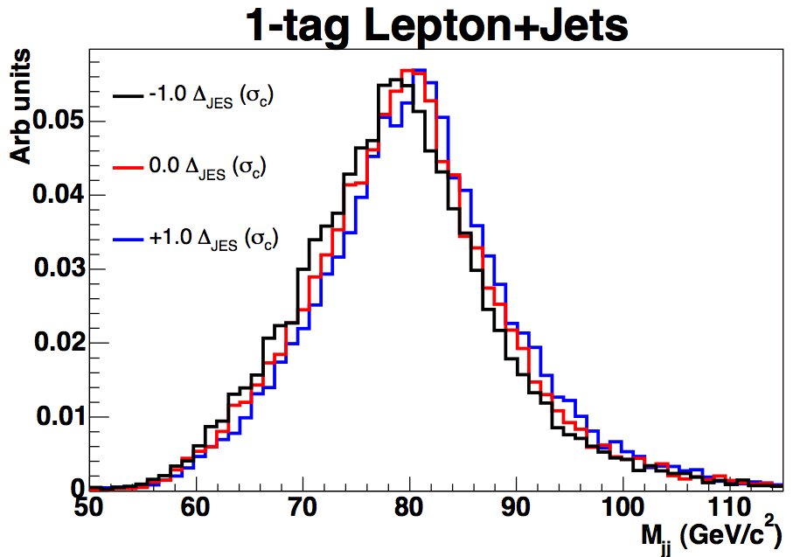
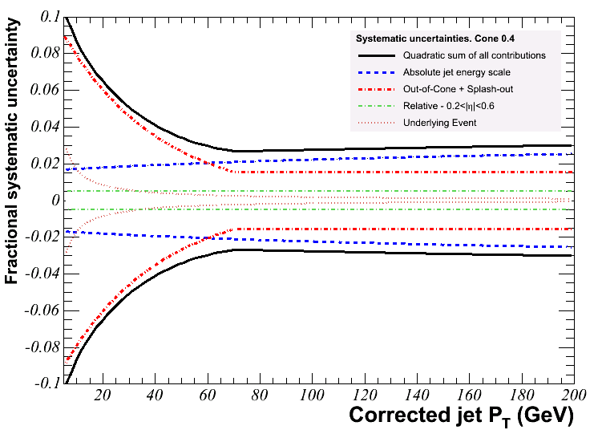
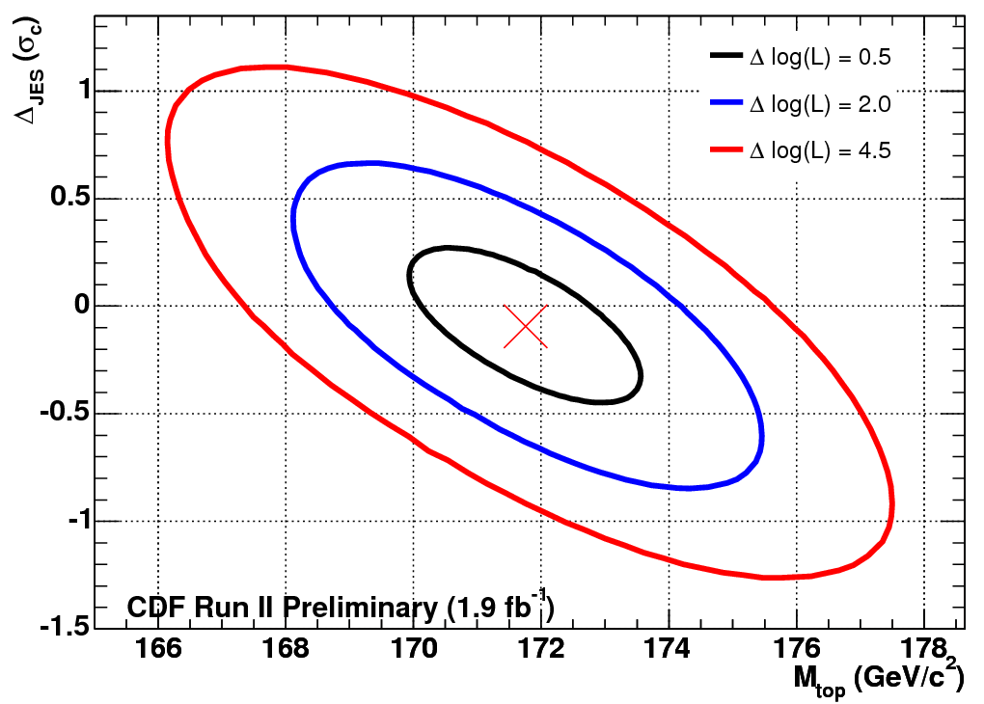
In-situ JES Measurement
M_{jj}
  E_{jet}=E_{meas}(1+Δ _{JES} *σ_{JES}(P_{t}))
--- Out of cone
--- Absolute
Notes:
Use top decays that have at least one of the W’s decaying hadronically to calibrate the JES and fit both the JES and mass simultaneously. Scale the jet energies to match the W mass spectrum. This technique significantly improved the systematic uncertainty on the top mass measurements (except dilepton channel where this is not possible).

Slide 8
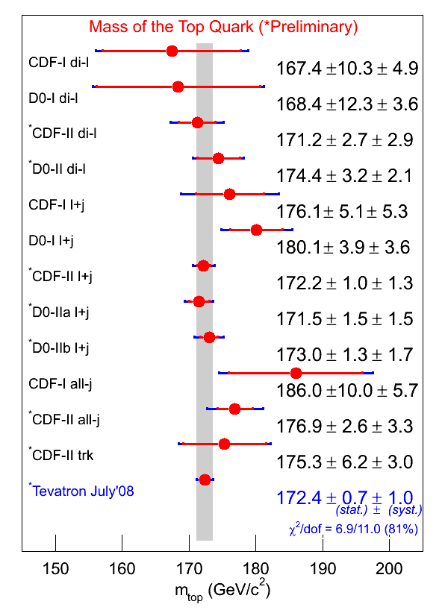
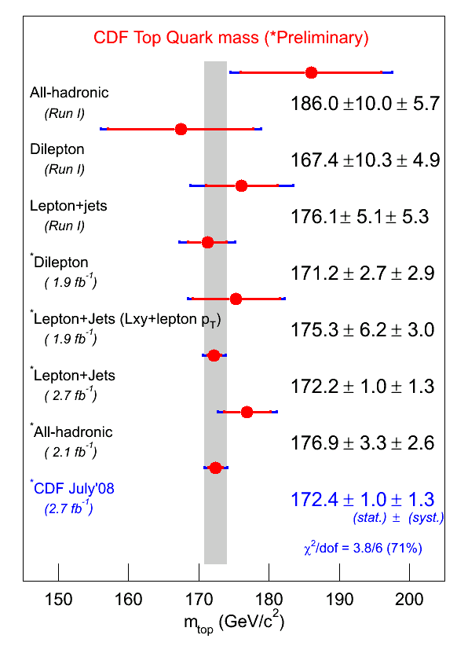
Combination @ ICHEP ‘08
Run I
Each channel Run II
172.4±1.2 GeV
Notes:
Most recent Tevatron results using up to 2.8 fb-1 combined with the Run I published results (took best results from each channel in Run II). L+jet Run II results account for ~90% of the combination. Combined uncertainty is 1.2 GeV which is a 0.7% relative precision. On right showing you latest results from CDF at ICHEP. Notice that the masses are moving together (no longer see separation between channels). Included new technique which has less dependence on JES (Lxy+LeptonPT). What I want to show you today are some new ideas which build on standard techniques used previously plus some new ideas which at the Tevatron are not the most precise measurements but which were tested out there for use at the LHC (statistically limited but less affected by JES).

Slide 9
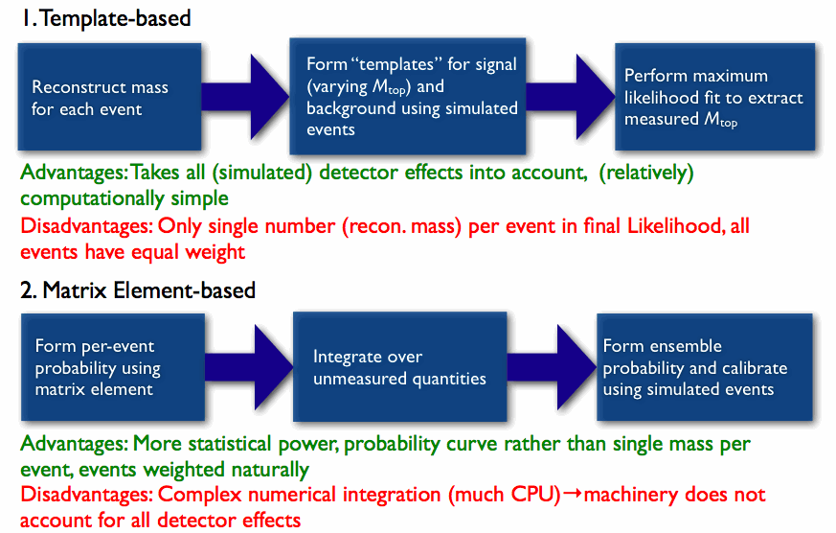
Reconstructing the Mass
See NWA talk by Joerg Meyer from Grenoble workshop in 2007
See talk by Marion Arthaud from Grenoble workshop in 2007
Notes:
Not going to spend much time talking about methods for measuring the top mass – last year’s workshop emphasis was on the top mass and there were some very nice talks describing a template based technique using neutrino weighting to solve for the underconstrained kinematic fit in the dilepton channel by Joerg Meyer and the matrix element technique which has been used in all channels by Marion Arthaud. Both CDF and D0 utilize these techniques. I will briefly mention the overall strategy and differences between the two but what I want to show your are a few new ideas which have been applied to these techniques recently.

Slide 10
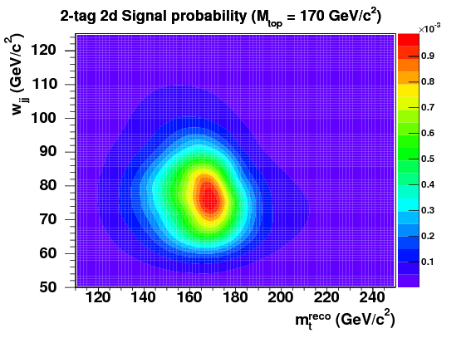
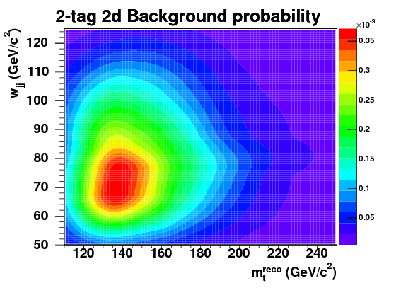
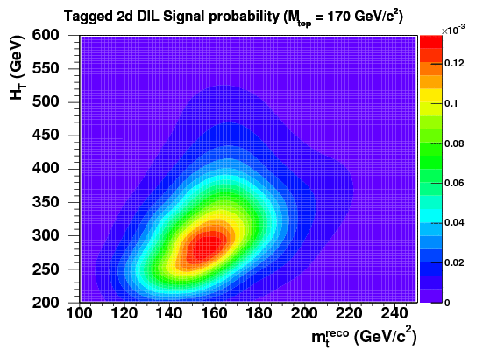
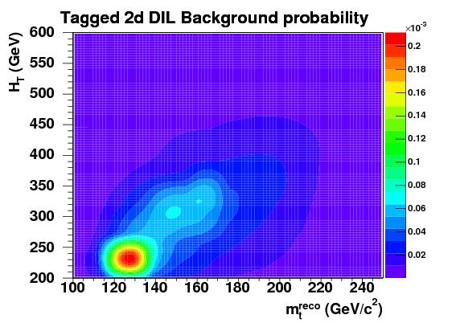
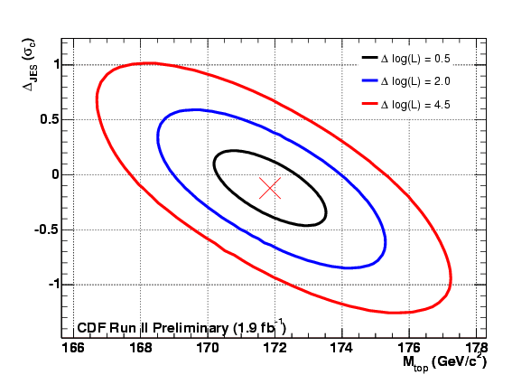
The template technique
Generic Template Method
SIG
BCK
MC
tt
backgrounds
Event reconstruction
L+JETS
SIG
BCK
DILEPTON
DATA
Event reconstruction
Likelihood
Fit
03/04/2008

Slide 11
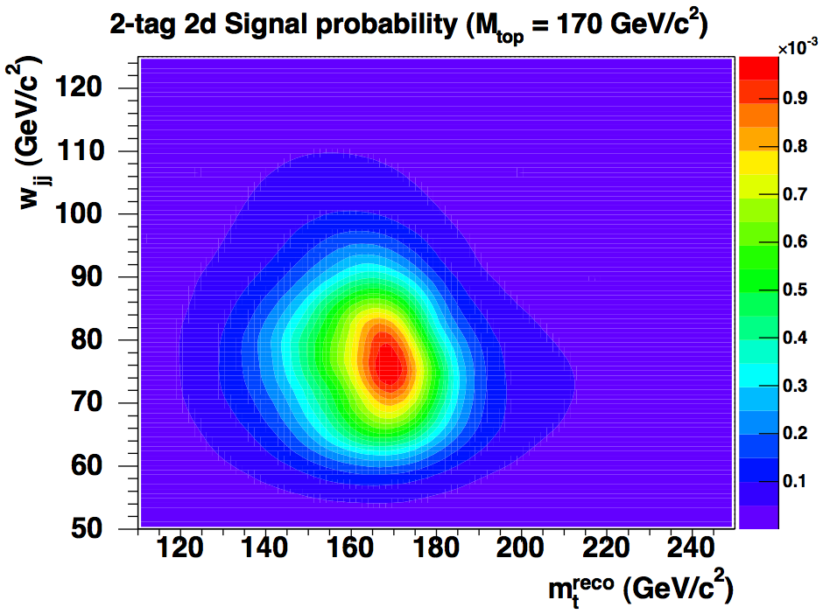
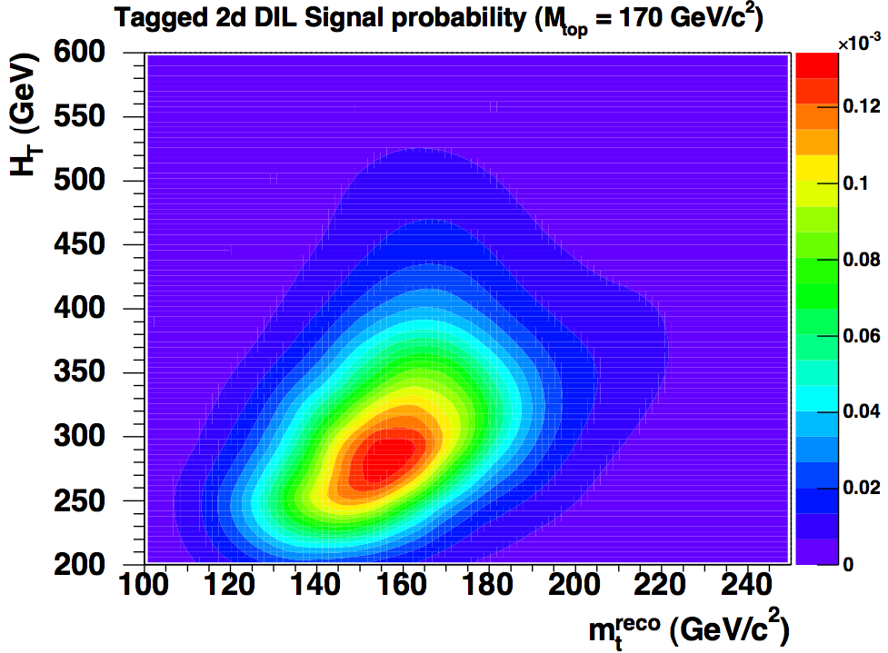
New Twist on Template Method
Simultaneous fit in 2 channels :
  L+jets and Dilepton
In-situ JES calibration applied in both channels
No assumptions:
  Correlations in systematics
  On likelihood shapes
L+JETS
DILEPTON
PRD submitted for 1.9 fb⁻¹ result: hep-ex. 0809.4808
Notes:
Simultaneous fit in 2 channels (L+jets and dilepton). Standard 2D template fit in L+jets (using a kinematic fitter to get the reconstructed top mass (M_t^reco) and use Mjj for the in-situ JES calibration. Then use the JES measurement from the L+jets to constrain the JES in the dilepton channel. In dilepton channel use standard neutrino weighting technique to get the (M_t^reco) but can can more sensitivity if also add second observable, Ht (scalar sum of transverse energy of ttbar decay products). Other improvements to standard template method are using kernel density estimates (KDE) and local polynomial smoothing (LPS). KDE allows one to make non-parameteric probably density functions (before typically used polynomial form to describe template shapes). KDE can only calculate probably density functions at way for which you have MC samples so to extrapolate between mass points use LPS.

Slide 12
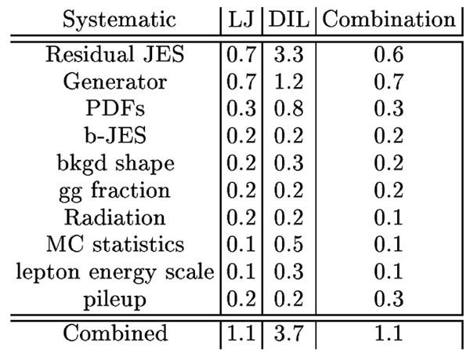
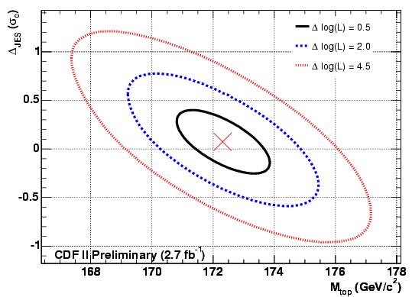
Template Results with 2.7 fb⁻¹
Measurements in traditional
manner (i.e. DIL no in-situ JES)
Mtop = 172.3 +/- 1.5 (stat.+JES) +/- 1.1 (syst) GeV/c²
= 172.3 +/- 1.9 GeV/c²
Comparable to L+jets Matrix Element analysis with 2.7 fb⁻¹:
Mtop = 172.2 +/- 1.3 (stat.+JES) +/- 1.0 (syst) GeV/c²
= 172.2 +/- 1.7 GeV/c²
Notes:
Need to understand residual JES (why is DIL JES still so large – because this is the dilepton alone without using in-situ JES). Template result using the combination is similar sensitivity to ME result now.

Slide 13
Generic Matrix Element Method
W(x,y) is the probability that a parton
level set of variables y will be measured
as a set of variables x
Probability to observe a set of kinematic variables x for a given top mass
d^{n}σ is the differential cross section
Contains (LO) matrix element squared
f(q) is the probability distribution that a parton will have momentum q
Normalization depends on m_{t} includes acceptance effects
Integrate over unknown q₁,q₂, y
q
b
q’
Maximal extraction of information, but phase
space integration is very CPU intensive
Additional background probability term with
varying levels of sophistication
t
R. Demina (Rochester, D0)
t

Slide 14
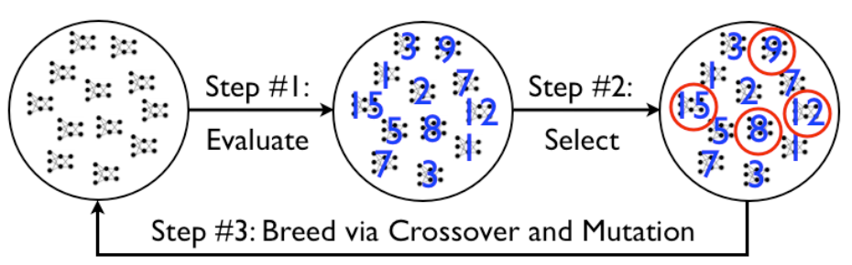
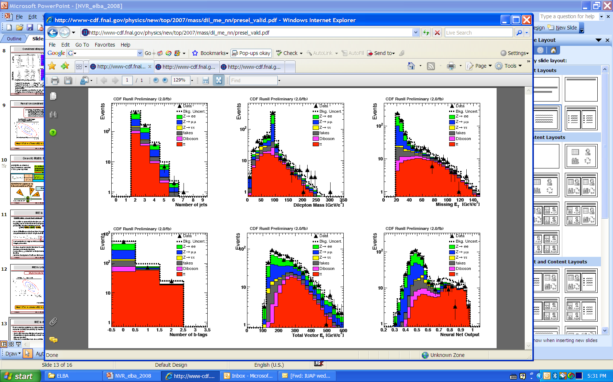
Optimizing Dilepton Selection
Event selection optimized to yield smallest expected statistical uncertainty by means of neuro-evolution:
Start with random collection of neural nets
Determine analysis sensitivity of each network
(fitness function)
Discard low sensitive nets and combine
topology and node weights through mutation
Neuro-evolution optimization
KEEP
Converged NNet
Ref: S. Whiteson and D. Whiteson, Proceedings of the Nineteenth Annual
Innovative Appllications of Artificial Intelligence Conference, p1819-1825, July 2007
K. Stanley and R. Miikulainen, Evolutionary Computation 10(2):99-127, 2002
Notes:
Past dilepton top mass analyzes used the same selection as cross section analyzes which were optimized for signal purity. Want to optimize selection for getting the smallest expected statistical uncertainty on the mass. Typical NNs trained to separate signal from background and classify events as one or the other. For mass not all backgrounds are created equal. Some backgrounds processes are less harmful. New idea here is to use an evolutionary neural network for the event selection.

Slide 15
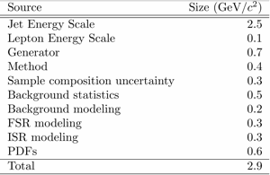
Dilepton Results using 2.0 fb⁻¹
After event select use matrix element technique
New event selection expected statistical uncertainty improvement of 20%
Mtop = 171.2 +/- 2.7 (stat.) +/- 2.9 (syst) GeV/c²
= 171.2 +/- 4.0 GeV/c²
Submitted PRL: hep-ex/0807.4652
Notes:
Systematics are still dominated by JES. Tevatron is now starting to explore techniques which are statistically limited for now but less sensitive to JES. Show on-going work on some of these.

Slide 16
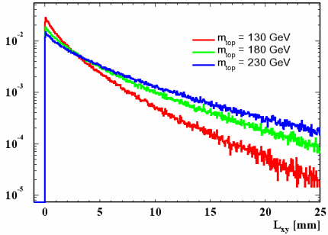
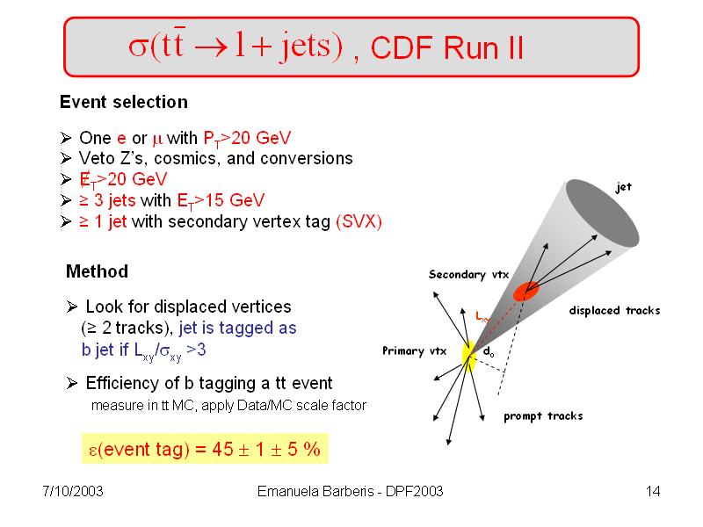
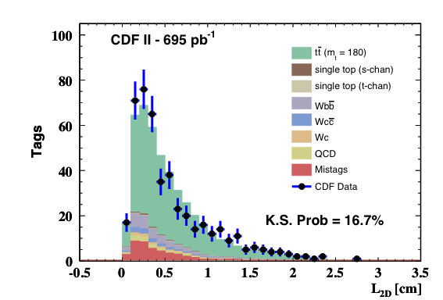
L+jets Template Method using L_{xy}
L_{xy} = average transverse decay length of B-hadron
L_{xy} ∝ b-jet boost ∝ M_{top}
L_{xy}
L_{xy} (mm)
Mtop = 180.7 +15.5/-13.4 (stat) +/- 8.6 (syst) GeV/c²
PRD 75:071102 (2007)
L_{xy} (cm)
Notes:
Previous result used average transverse decay length, Lxy, of the b-hadrons. Choose this variable to minimize the JES systematic. Lesson here about the jet energy scale. Smaller here since only went to Level-5 corrections (absolute corrections and didn’t do out of cone which is much bigger due to acceptance affects).

Slide 17
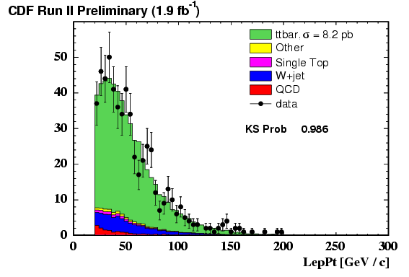
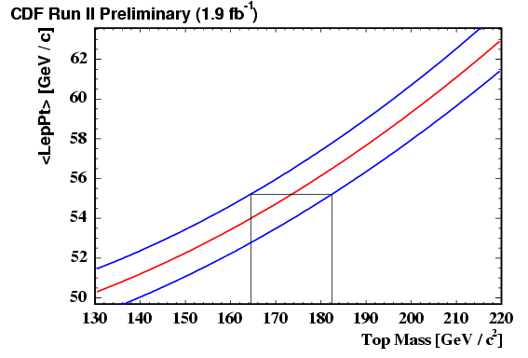
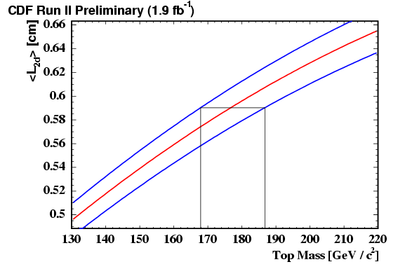
L+jets - Combining Lepton P_{t} + L_{xy}
Mean
±1σ
P_{t} of lepton
from W decay
L_{xy}
Mtop = 176.7 +10/-8.9(stat) +/-3.4(syst) GeV/c² using L_{xy} alone
Mtop = 173.5 +8.9/-9.1(stat) +/-4.2(syst) GeV/c² using Lepton P_{t} alone
Combined Result using 1.9 fb⁻¹:
Mtop = 175.3 +/- 6.2 (stat.) +/- 3.0 (syst) GeV/c²
Notes:
Have recently updated the Lxy analysis but added Lepton Pt information as well. The Pt of the lepton from the leptonically decaying W is mostly uncorrelated with the Lxy. Can combine these 2 results to improve uncertainty. Use mean from PEs to generate the red lines. The 1 sigma blue lines come from the systematics fluctuation. Use mean value from data distribution to then get top mass and use the blue bands for the statistical uncertainty. Combine the 2 results using a likelihood.

Slide 18
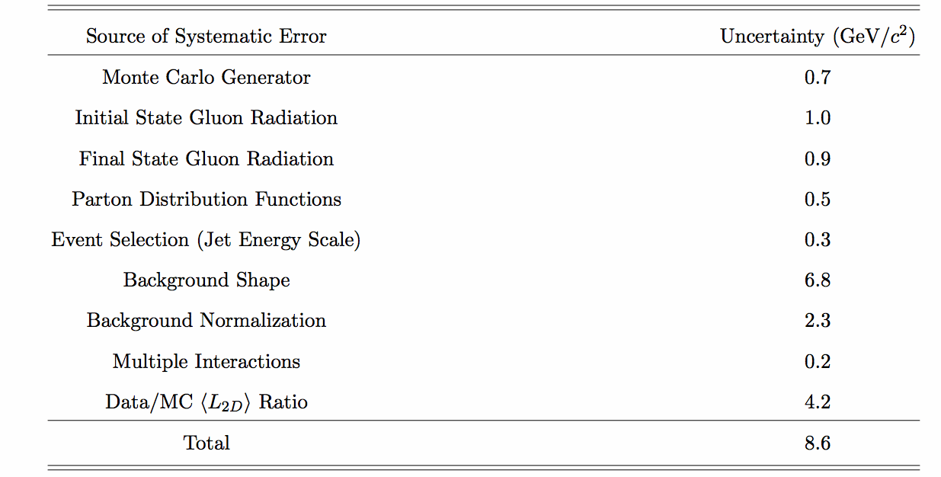
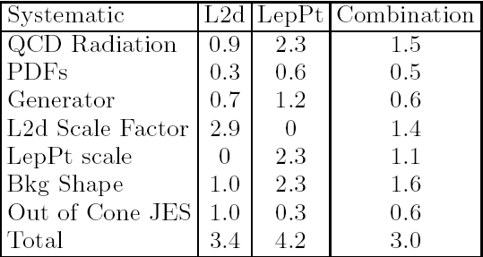
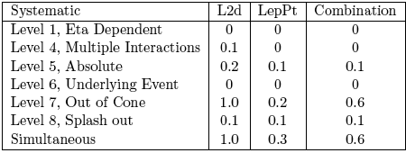
Interesting Lesson…
L_{xy} and Lepton P_{t} don’t depend on JES, right?
Systematics for L_{xy} and LepP_{t}
results using1.9 fb⁻¹
Systematics for L_{xy} result using 695 pb⁻¹
Event selection was affected for jets near 20 GeV threshold cut
Notes:
The main reason to try using the transverse decay length and lepton Pt variables was to reduce the systematic from the JES. The thought was analysis doesn’t use any kinematic quantities from jets so assume won’t be affected. This is true for the Lepton Pt but as it turns out it does for the Lxy shifting the JES in this case affects the event selection. Jets near the 20 GeV threshold happen to have a significantly lower than normal average Lxy so when you shift the jet energy more smaller Lxy jets pass selection shifting the Lxy templates down affecting the top mass. For jets with Pt <40 GeV the JES is dominated by the out of cone systematic and see effect in table (Level-7). Aside here is that this effect wasn’t seen in the previous analysis because only corrected to particle level (Level-5) and not all the way to parton level. Despite the JES affecting this result more than anticipated the good news is that several of the systematics scale with luminosity. For example the largest systematic Lxy Scale factor (which is a correction factor applied to the Lxy measured in MC) is mostly due to the lack of statistics in the high Et jets of the HF dijet sample. Can also reduce the affect from the JES by cutting harder on the jet threshold.

Slide 19
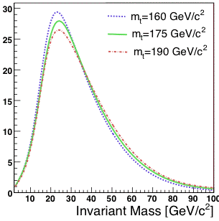
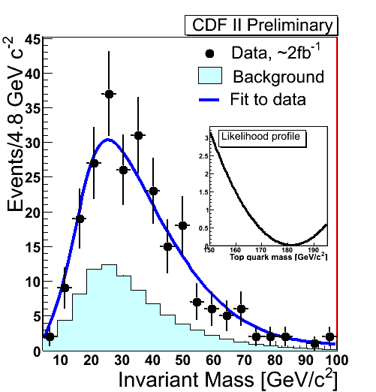
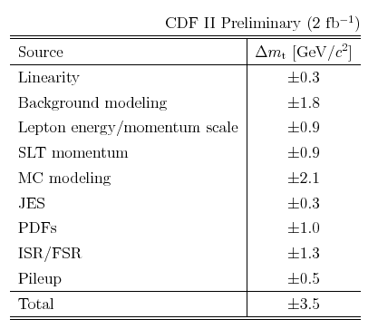
L+jets - Template Method using SLTu
Invariant mass of lepton from W and muon from semileptonic b decay
Mtop = 181.3 +/- 12.4(stat.)
+/- 3.5 (syst) GeV/c²
Notes:
One other technique being investigated at Tevatron as test-bed for LHC. Use the invariant mass of the lepton from the W decay and the muon from the semileptonic b-decay.

Slide 20
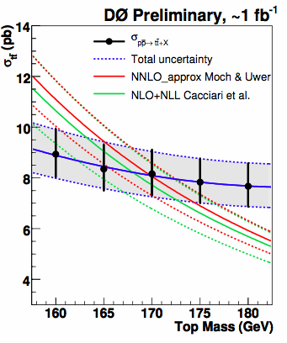
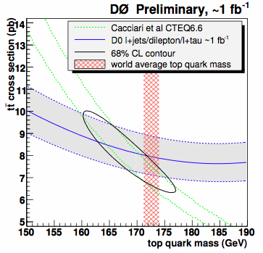
Top Mass from the Cross Section
D0 combined Xsec
Using NLO+NLL
Mtop = 167.8 +/- 5.7 GeV/c²
Notes:
One other technique being investigated at Tevatron as test-bed for LHC. Use the invariant mass of the lepton from the W decay and the muon from the semileptonic b-decay.

Slide 21
Systematic Uncertainties
Systematics, Systematics, Systematics
Current list:
Working on:
JES (for non-in situ)
Residual JES
b-JES
ISR&FSR
PDF uncertainties
Generator & modeling
Multiple interactions (a.k.a Pile-up)
Background fraction & Shape
Lepton Energy scale
MC generators: checking against NLO MCs
Color reconnection – more later
Systematics for Template Analysis
using 2.7 fb⁻¹
Notes:
Just shown you many different techniques for measuring the top mass at the Tevatron. Most of these are systematics dominated. Priority has now shifted to scruntinizing the errors. CDF and D0 are having frequent workshops to discuss the top mass systematics. Comparing lists and standardizing meanings to make combinations (not just mass – cross section, W helicity, etc.) easier. At this point we are focusing on removing double counting of systematics (reduce errors) and (more worrisome) what effects are we missing – for example color reconnection.. Could easily spend hours talking on just the systematics (the workshops regularly do). I will briefly go over residuel JES, b-JES and color reconnection work.

Slide 22
Residual JES
Use jets from hadronic W resonance in messy ttbar environment to measure the average response of jets
In-situ measured JES does not fully measure shifts in JES scale along different parameter space curves (e.g. jet P_{t} and η)
Even for in-situ measurement still evaluate JES uncertainty using standard procedure by shifting JES +/- 1σ
  Must re-compute acceptances and shapes for both ttbar and backgrounds

Slide 23
JES for b quarks
Derive JES from W daughter jets, but b jets carry most M_{top} information
Study 3 components due to difference between b and q jets:
  Semi-leptonic branching ratios
    Move b anc c BRs together by +/- 1σ
  B fragmentation uncertainties
    Reweight to LEP/SLD Bowler parameters
  Calorimeter response uncertainties
    Shift b-jet energies by +/-1% then re-run PEs

Slide 24
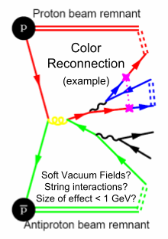
Remaining issues
Color Reconnection Studies
Pythia 6.4 includes:
  P_{T} ordered showering which allows for parton showers to interact with the underlying event
  new color reconnection models
Study by Wicke and Skands on toy top mass measurement see ~1 GeV differences
  see Wicke and Skands, arXiv 0807.3248 and hep-ph/0703081

Slide 25
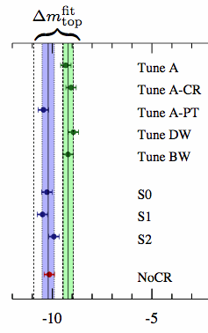
Remaining issues
Color Reconnection Studies
Virtuality ordered PS (old)
P_{T} ordered PS (new)
Results:
  Total spread +/- 1 GeV
CDF and D0 are both working on studying these new Pythia tunes within our analysis methods

Slide 26
Final Thoughts…
Many analysis techniques to measure top mass
  Tevatron still learning new tricks
  Test bed for methods for LHC
Mass is now known to 0.7%
Need to be absolutely confident in the systematic
uncertainties we quote – working hard on this
Tevatron top mass results at:
  CDF - http://www-cdf.fnal.gov/physics/new/top/public_mass.html
  D0 - http://www-d0.fnal.gov/Run2Physics/top/top_public_web_pages/top_public.htm
and one final question…
What mass are we measuring anyway?
Notes:
Leave you with one last question… Has already been a source of debate now that we are near 1 GeV precision and I’m sure this will be continue to be up for debate for some time to come.

Slide 27
Backup Slides
Notes:
Leave you with one last question… Has already been a source of debate now that we are near 1 GeV precision and I’m sure this will be continue to be up for debate for some time to come.

Slide 28
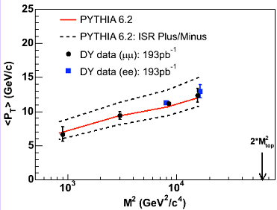
ISR & FSR
ISR/FSR
Use dedicated Pythia samples with increased/decreased amount of ISR/FSR
Variations in pythia parameters are determined by studying dimuon events
only sensitive to ISR
FSR parameters are varied within similar bounds, assuming the physics is similar
Extrapolation from DY data to ttbar events is large
Pythia parameters control mainly the soft part of FSR, might overlook hard (NLO
type) radiation
Will try to pin down this uncertainty band
by using new data and adding higher mass points
Currently changed to samples where ISR and FSR are simultaneously increased or decreased

Slide 29
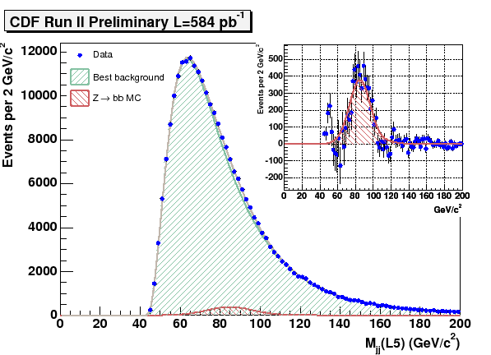
b-JES using Z(bb)
Di b-jets with Et>22 GeV, ΔΦ>3.0,E_{t}^{(3rd)}<15 GeV
using SVT impact parameter trigger at L2
To measure data/MC b-JES
Has not applied to b-JES
in top mass
  different cone size
  different pt spectrum

Slide 30
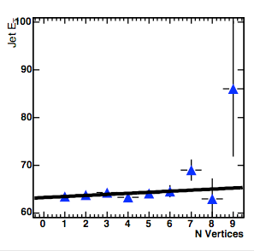
Multiple Interactions (Pile-up)
Problem
Our MC simulates only one parton-parton interaction per event
We add additional min bias events according to our lumi profile and determine
JES correction
In ttbar events our MC still underestimates the amount of multiple parton-
parton interactions in each collision
How does this propagate into an Mtop uncertainty ?
B-Jet Et increases with ~200 MeV
For each additional vertex
We find mean of ~2 vertices per event in
our current 2 fb⁻¹ dataset
We know that B-Jets affect M_{top} most
We know how a 1% bjet ET increase affects M_{top}
Total effect is O(200 MeV) on M_{top}

