Slide 1
Perspectives from DOE NP
EIC User Meeting
July 22, 2019
Paris, France

Slide 2
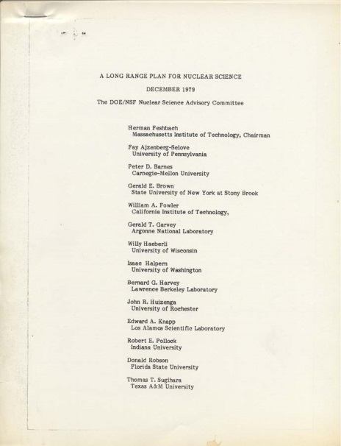
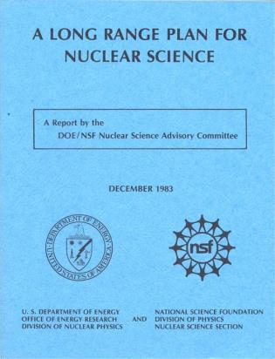
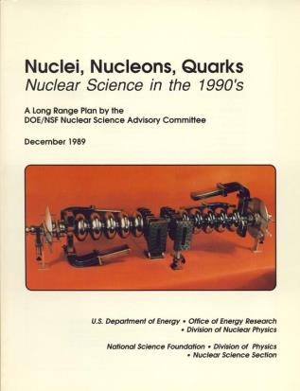
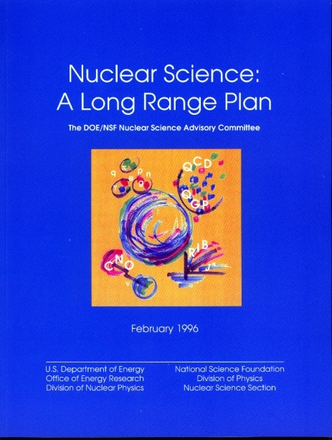
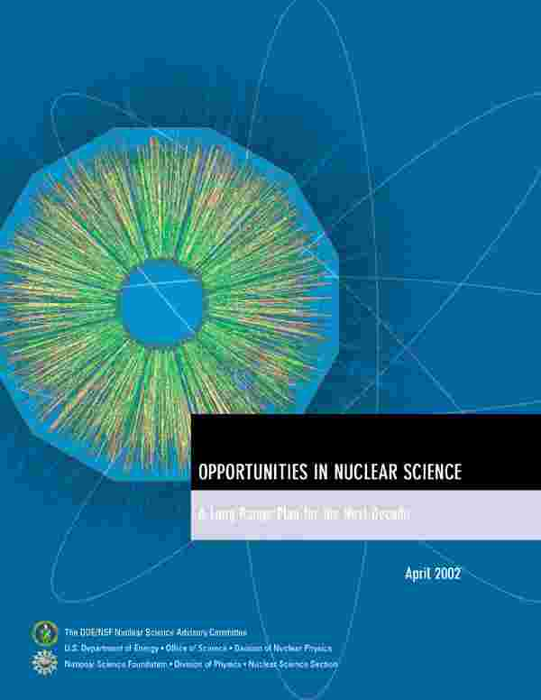
How Strategic Direction Have Been Established in the U.S. Nuclear Science Program
1979
1983
At a high level, the Nuclear Science Advisory Committee (NSAC) is periodically charged to provide recommendations regarding compelling science opportunities and their priority.
1989
1996
2002
2007
Strategic plans are then developed to implement those priorities within the constraint of available funding.
SC/NP strategic plans are also influenced by National Academy reports and White House, OSTP and Interagency Working Group (IAWG) efforts.

Slide 3

The 2015 Long Range Plan for Nuclear Science
Recommendations:
Capitalize on investments made to maintain U.S. leadership in nuclear science.
Develop and deploy a U.S.-led ton-scale neutrino-less double beta decay experiment.
Construct a high-energy high-luminosity polarized electron-ion collider (EIC) as the highest priority for new construction following the completion of FRIB.
Increase investment in small-scale and mid-scale projects and initiatives that enable forefront research at universities and laboratories.

Slide 4
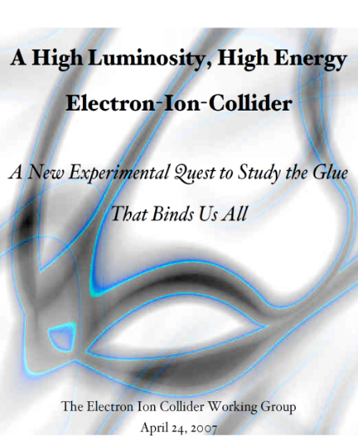
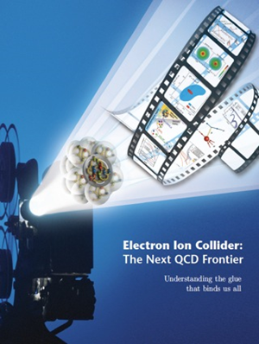

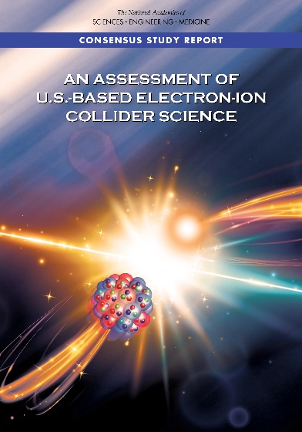
The Science Foundation for An Electron-Ion Collider
2002
A strong community emphasis on the urgent need for a machine to illuminate the dynamical basis of hadron structure in terms of the fundamental quark and gluon fields has been a persistent message for almost two decades
2007
2009
2010
Gluons and the Quark Sea at High Energies
2012
“a high-energy high-luminosity polarized EIC [is] the highest priority for new facility construction following the completion of FRIB.”
2013
Major Nuclear Physics Facilities for the Next Decade
2015
NSAC
“…essential accelerator and detector R&D [for EIC] should be given very high priority
in the short term.”
“We recommend the allocation of resources …to lay the foundation for a polarized Electron-Ion Collider…”
“..a new dedicated facility will be essential for answering some of the most central questions.”
March 14, 2013
2018
“The quantitative study of matter in this new regime [where abundant gluons dominate] requires a new experimental facility: an Electron Ion Collider..”
Electron-Ion Collider..absolutely central to the nuclear science program of the next decade.

Slide 5

NAS Assessment of a U.S. Based Electron-Ion Collider
First 4 findings:
Finding 1: An EIC can uniquely address three profound questions about nucleons — neutrons and protons — and how they are assembled to form the nuclei of atoms:
    How does the mass of the nucleon arise?
    How does the spin of the nucleon arise?
    What are the emergent properties of dense systems of gluons?
Finding 2: These three high-priority science questions can be answered
by an EIC with highly polarized beams of electrons and ions, with sufficiently
high luminosity and sufficient, and variable, center-of-mass energy.
As a result of the comprehensive survey the committee made of existing and planned accelerator facilities in both nuclear and particle physics around the world, it finds that:
Finding 3: An EIC would be a unique facility in the world and would maintain […] leadership in nuclear physics.
An EIC would be the only high-energy collider planned for construction in the United States. Its high design luminosity and highly polarized beams would push the frontiers of accelerator science and technology. For these reasons, the committee finds that
Finding 4: An EIC would maintain […]. leadership in the accelerator science and technology of colliders and help to maintain scientific leadership more broadly.
2018

Slide 6
The Technical Foundations for EIC: Accelerator R&D
  The EIC will be one of the most complex and sophisticated collider accelerators ever built. The machine requirements push the state-of-the-art on many fronts including the high degree of beam polarization, high luminosity, beam cooling, beam dynamics, crab cavities for both beams, and an interaction region with complex magnets. EIC will be unique facility in the world and will maintain leadership in accelerator science and technology of colliders.
    NP Community Panel Review: Panel review charged with identifying high priority accelerator R&D aimed at technical risk reduction. Dr. Kevin Jones of SNS chaired this international panel. Panel Report published February 2017 (https://science.energy.gov/np/community-resources/reports/ )
    Bi-Annual FOA : Competitive accelerator R&D based on priorities established in EIC panel report. Funding level: ~$9-11 M per year for FY18 and FY19.
    Strong collaborations formed at the labs and with universities to advance different EIC concepts with collaborative common R&D effort.

Slide 7
The International Foundation for EIC: Meeting at IUPAP
DOE encourages international cooperation in EIC activities, including nuclear and accelerator sciences, detector and accelerator R&D, computing, engineering and construction efforts.
DOE-led EIC meeting with international funding agency and government representatives during the 5th IUPAP nuclear science symposium has been scheduled on August 3 at the University of Notre Dame London.
Attending are representatives of Australia, Brazil, Canada, France, Germany, Japan, Korea, India, Italy, Russia, UK and South-Africa.
Invitations are also being sent to CERN, Poland, Sweden, Romania

Slide 8
Current Status and Path forward of EIC
The “wickets” are substantially aligned for a major step forward on the EIC
A Mission Need Statement for an EIC has been approved by DOE
An Independent Cost Review (ICR) Exercise mandated by DOE rules for projects of the projected scope of the EIC is very far along
DOE is moving forward with a request for CD-0 (approve Mission Need)
DOE has organized a panel to assess options for siting and consideration of “best value” between the two proposed concepts
The Deputy Secretary is the Acquisition Executive for this level of DOE Investment
The FY 2020 President’s Request includes $ 1.5 million OPC. The FY 2020 House Mark includes $ 10 million OPC and $ 1 million TEC.

Slide 9
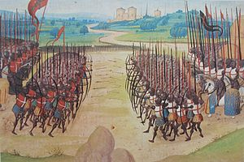

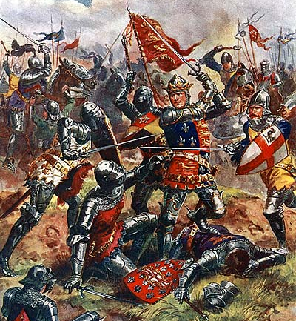
Additional Comments
The goal of DOE all along has been to have both communities work together constructively towards an EIC throughout the lead up, during construction, and implementation of the research program and that has informed the approach developed by NP, SC, and S4
The underlying philosophy; no big winner and no big loser:
Unlike Agincourt in 1415, the goal is “everybody wins”.
There is a chance, if the momentum continues, that the EIC could be “on a path” in the foreseeable future with the stage set for next steps (e.g. planning for how construction scope will be shared, detector R&D, etc.). Continued constructive community cooperation can play a big role in the pace of progress.

